Slide 1


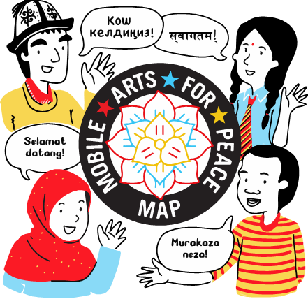

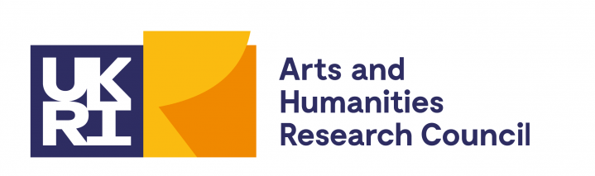

Exploring local cultural forms, engaging stakeholders, and informing policy and curriculum through arts-based research
Wednesday 14 May 2024

Slide 2




Overview of
Mobile Arts for Peace
(MAP)
Professor Ananda Breed
Principal Investigator (PI), MAP
Professor of Theatre
College of Arts, Social Sciences, and Humanities
University of Lincoln, UK

Slide 3
Overview of Mobile Arts for Peace (MAP)
One Drum per Girl (Rwanda)
The Magic of Theatre (Kyrgyzstan)
Dēudā Folklore and Mithala Arts (Nepal)
Angklung and Lenong Folk Theatre (Indonesia)
Findings and Next Steps: MAP Conference Invitation

Slide 4

Aims and Objectives
To provide a comparative approach on the use of interdisciplinary arts-based practices for peacebuilding
in Kyrgyzstan, Rwanda, Indonesia and Nepal by:
Influencing curricula and approaches to working with
in- and out-of-school youth to address global challenges
Creating structures and modes of communication
between youth and policy-makers from the local to global

Slide 5
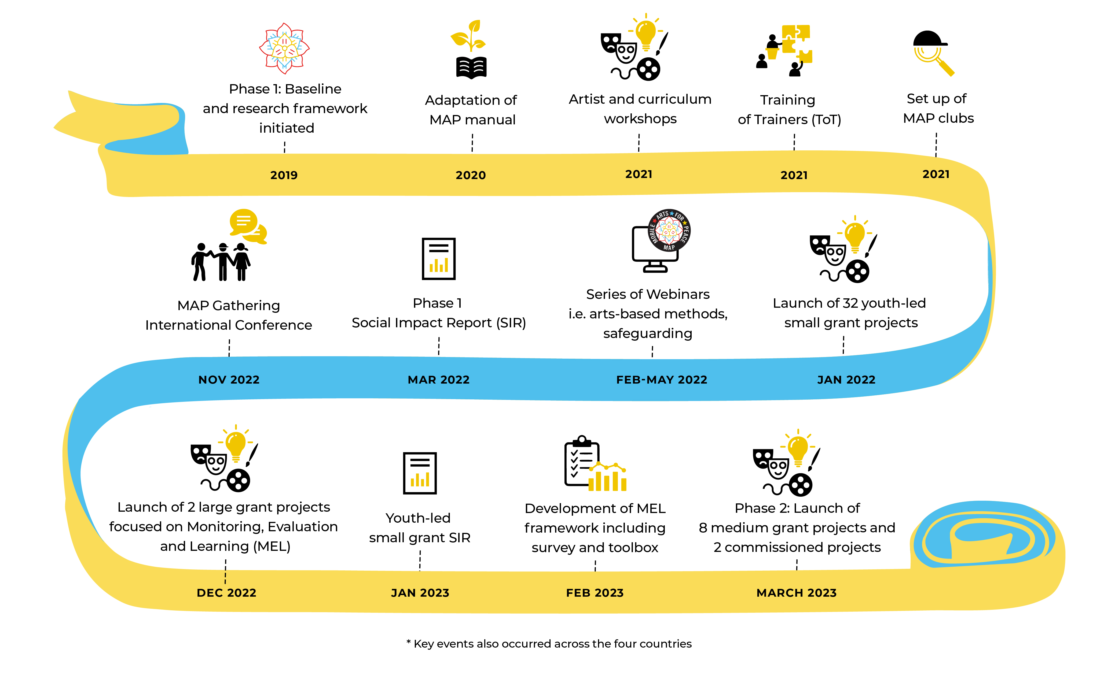
MAP Milestones

Slide 6


Overview
MAP engaged with over 7,250
research participants
(totalling over 28,124 since the initial implementation of MAP and sister UKRI GCRF Newton project MAP at Home)
created links with ​
194 partner
organisations
Delivered over
828 engagement activities
Produced over
279 artistic products to date
across Kyrgyzstan, Rwanda, Indonesia and Nepal.

Slide 7

Gira Ingoma - One Drum Per Girl
(Rwanda)
Partner organisation:
Woman Cultural Centre
​
Principal Investigator:
Gakire Katese Odile(PI)

Slide 8
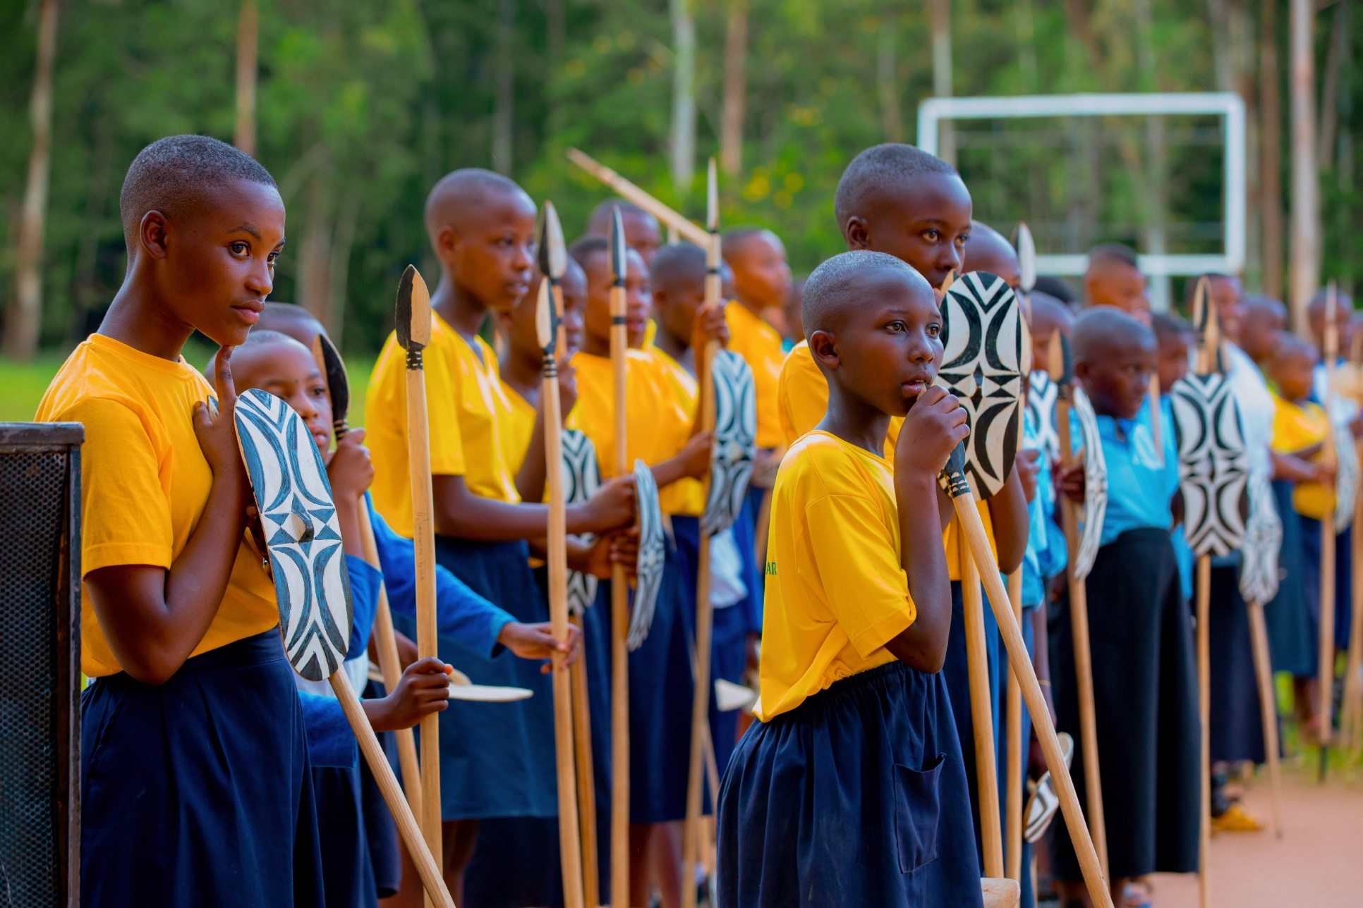
Culture under (re)construction
Girls & Women at work

Slide 9
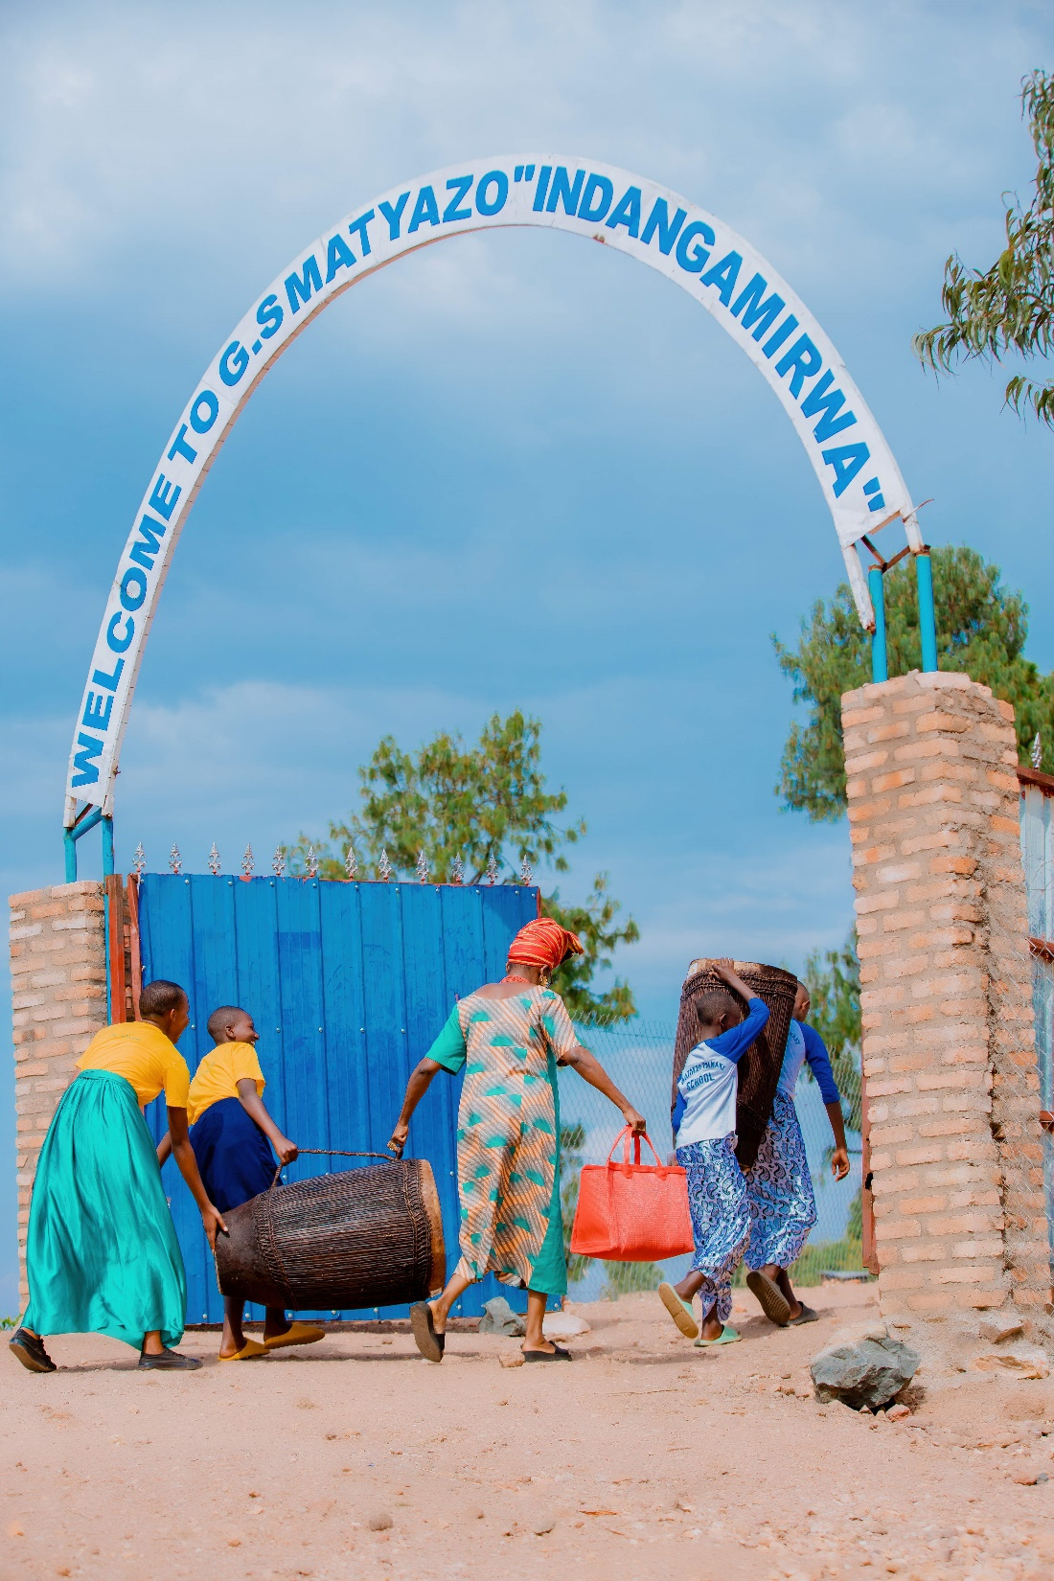
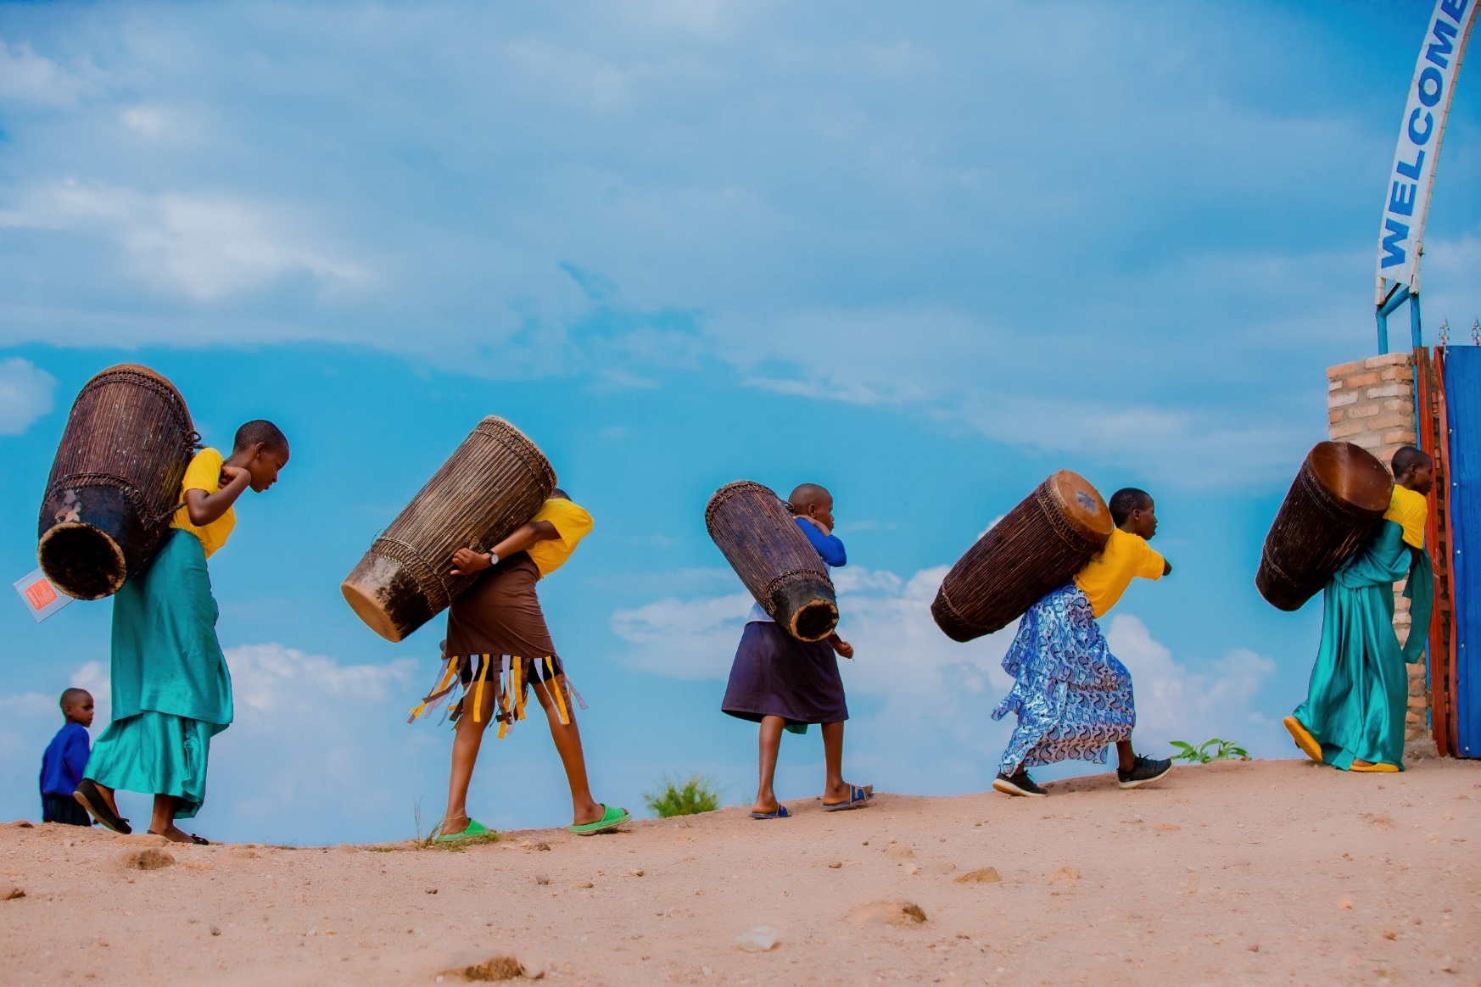
Ensuring that the Rwandan National Curriculum Framework in Music, Dance and Drama is gender responsive

Slide 10
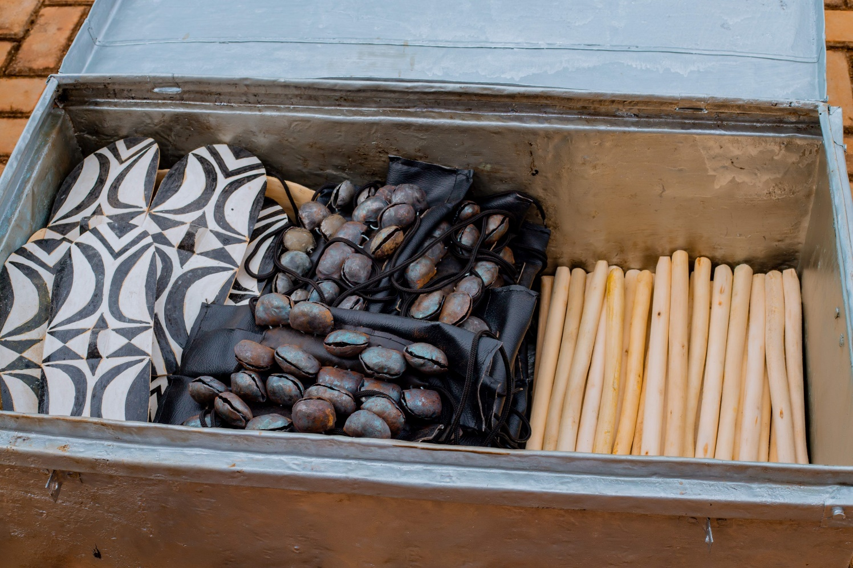
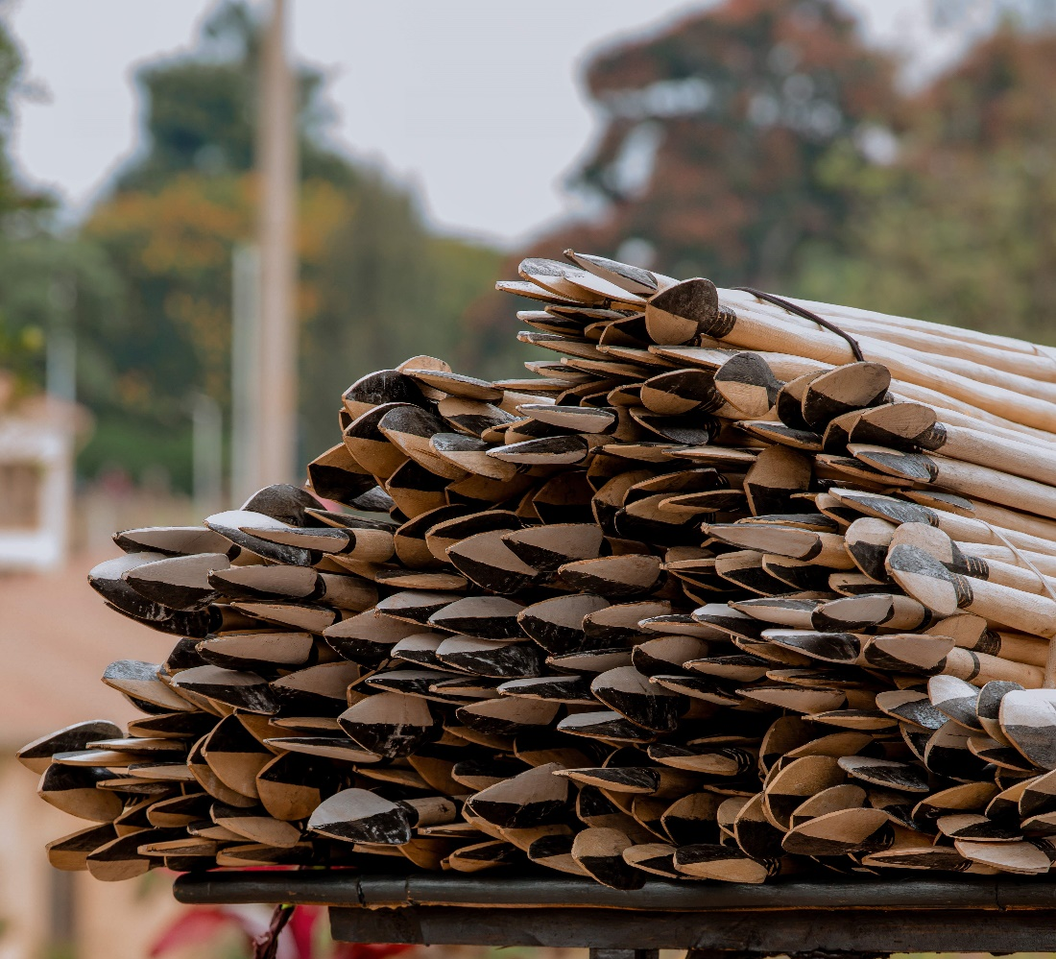
Transforming the arts of exclusion into arts of inclusion

Slide 11
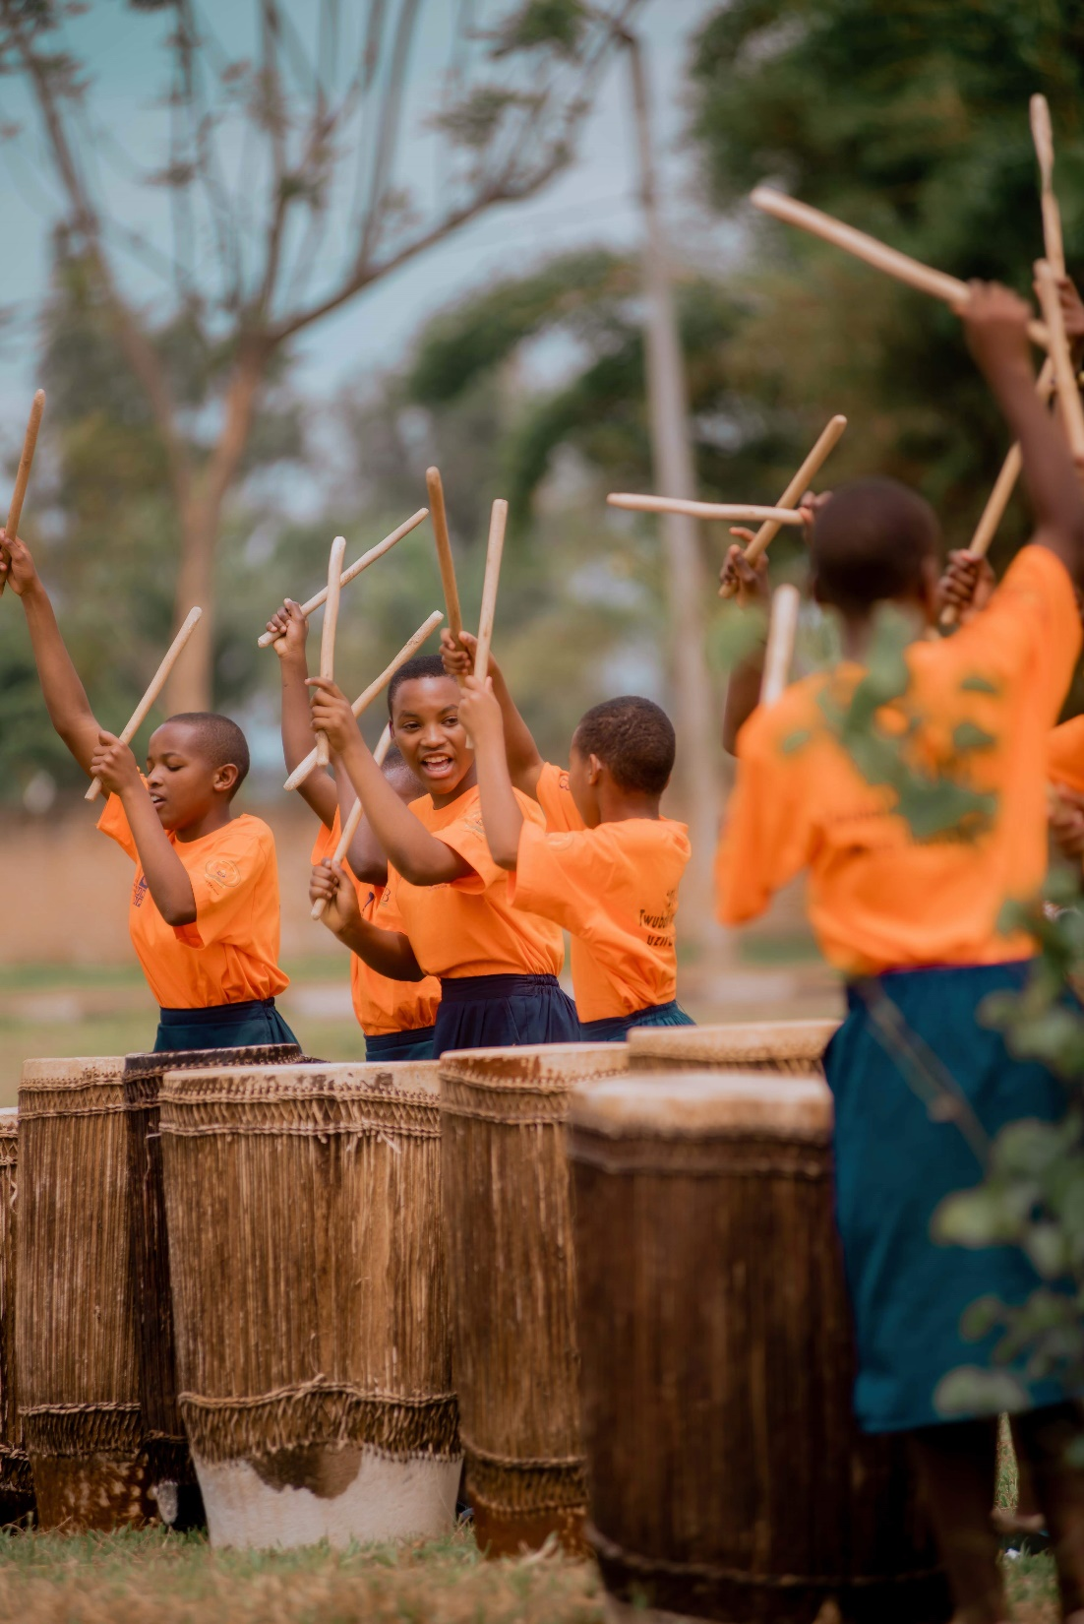
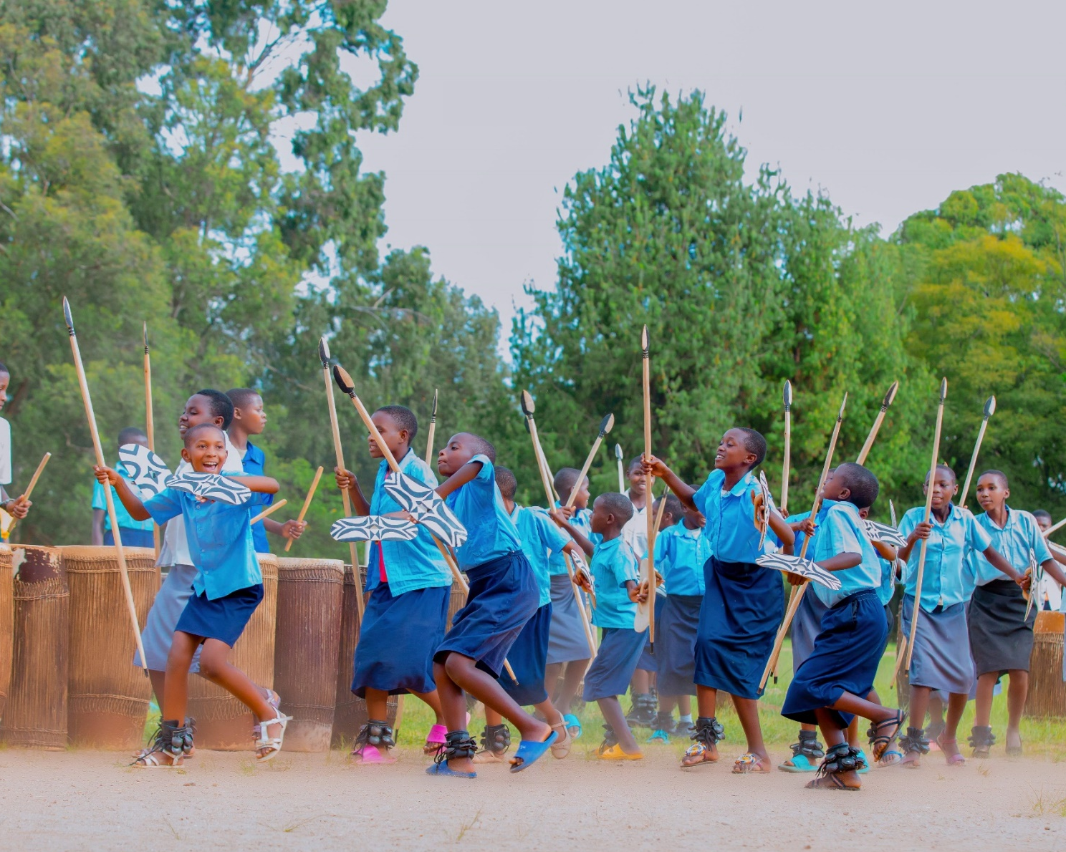
Drumming – Intore Warrior Dance Songs – Poetry – Juggling

Slide 12
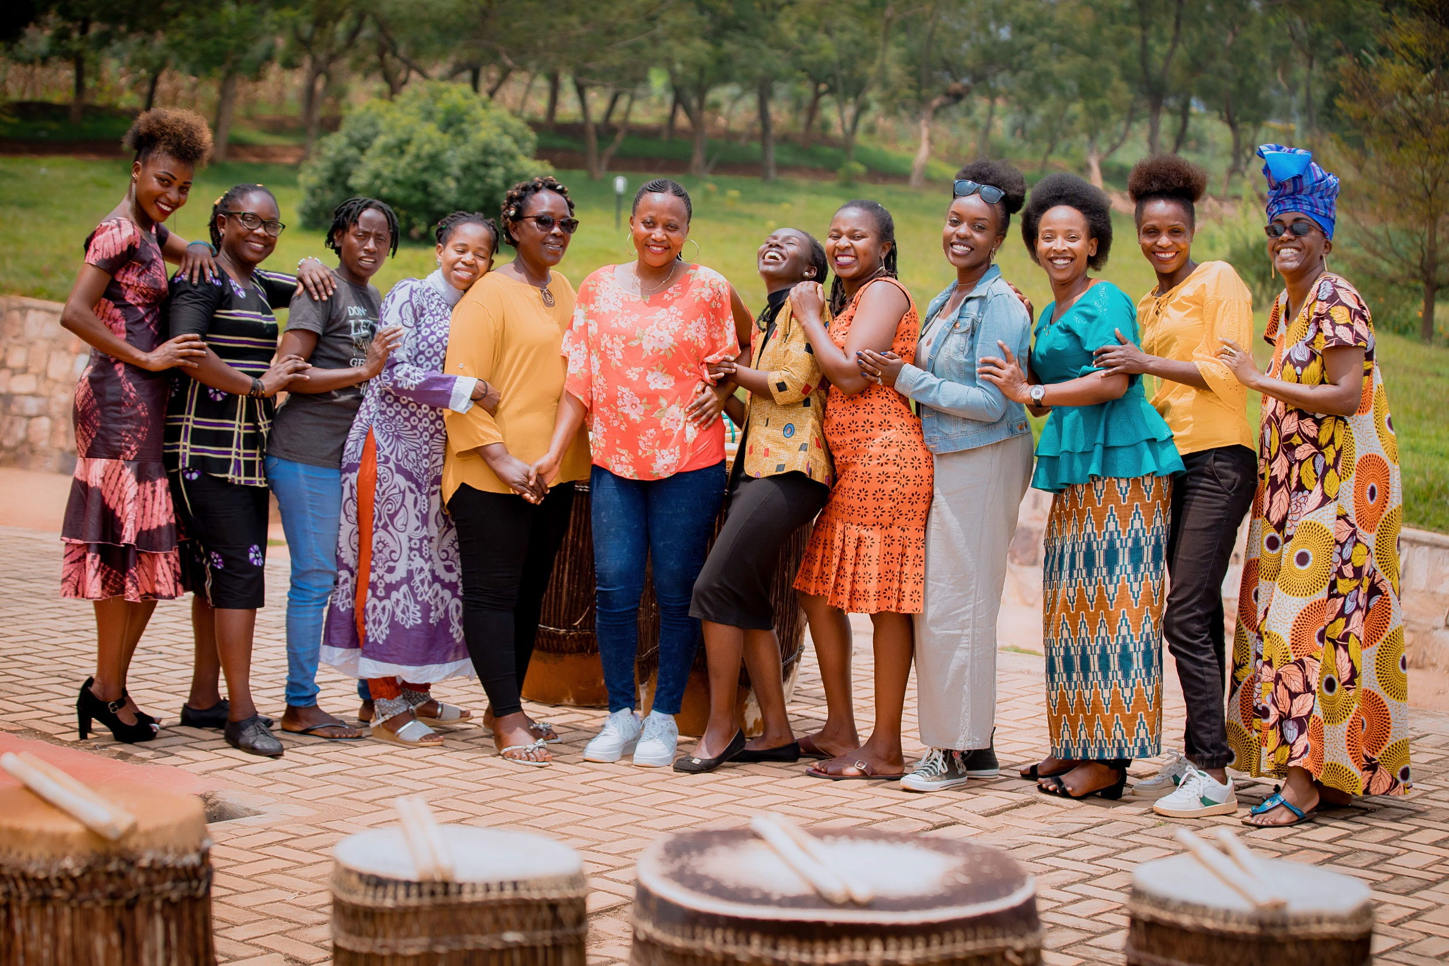
TEAM
12 drummers / pioneers / trainers / role models offer workshops every Saturday and Sunday
Up to 64 training workshops benefited over 275 girls
11 teachers pairing with trainers to delivering the workshops (12 sessions)

Slide 13
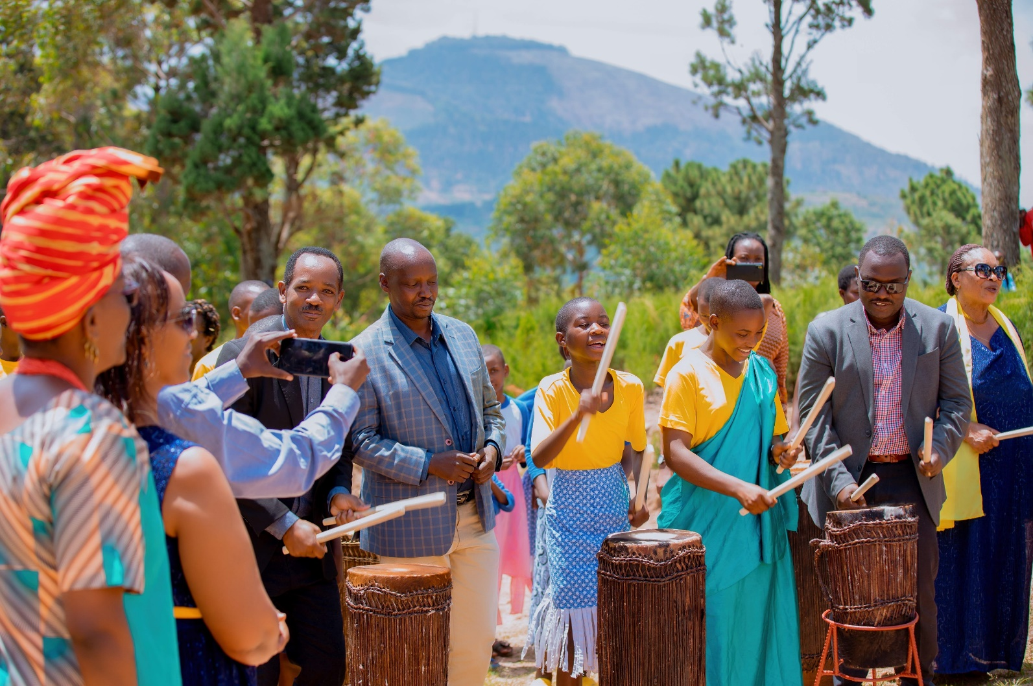
Dialogue with policymakers
8 March 2023
Executive Secretary of Ngoma Sector
Executive Secretary of Matyazo Cell
Vice Mayor of Economic Affairs
6 May 2023
Advisor to the Mayor, Gender Officer
Nursery, Primary Education and Adult Literacy Officer
Coordinator Joint Action Development Forum (JADF)
Profemmes – Twese Hamwe
Directors of 11 Schools

Slide 14


The Magic
of Theatre
Partner organisation: Jash Kubat​
​
Principal Investigator,
Nurlan Asanbekov

Slide 15
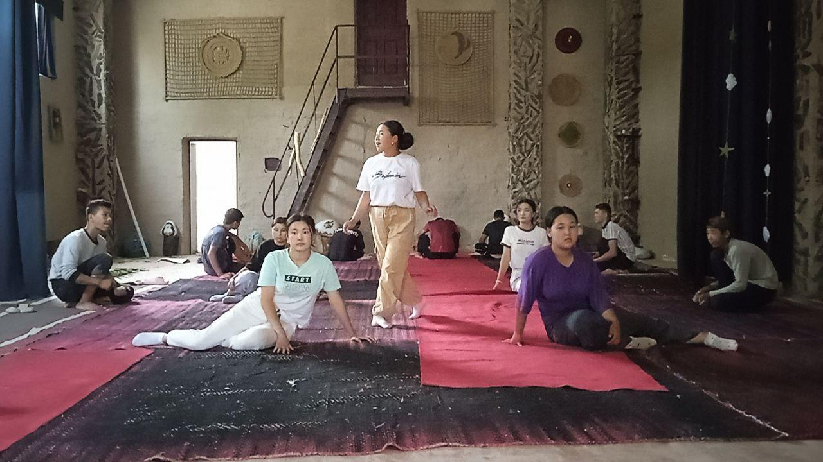
What is our approach?
The art of theatre in Kyrgyzstan refers to the ancient epic story-telling tradition. In general, there are more than 40 epic stories. The largest and the greatest is “Manas” which has been placed in the UNESCO list of Intangible Heritage.
Children from Jany-Zher have been working on one of the nature-related epic stories “Tak Teke”.
Rehearsing “Tak Teke”. Photo credits: Eldiyar Zharashev and Omurbek Bostonov

Slide 16
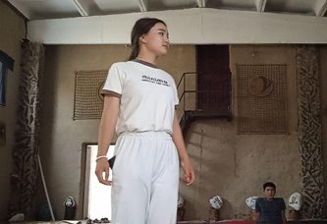
How does the Magic of Theater evoke dialogue?
Through workshops in performance, we aim to reveal the inner world of the child.
Seeking inter-generational dialogue by…
Developing partnership with Lyceum No. 43 in Jany-Zher to work with marginalised and underserved youth populations.
Conducting surveys, interviews, and focus groups among children, parents, artists, and policymakers about the importance of arts in education and society.
Exploring how the art of theater can influence the future of each child.
Credit: Eldiyar Zharashev and Omurbek Bostonov

Slide 17
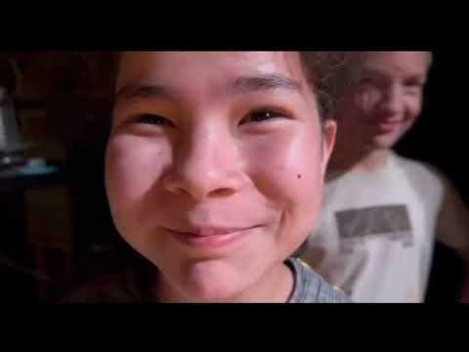
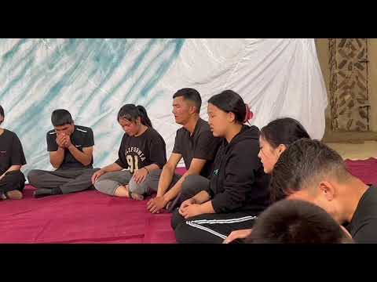
Work in Progress with Youth Theatre in Bishkek (May 2023)
Work in Progress in Jany-Zher of the 'Tak Teke' performance (May 2023)

Slide 18

Dēudā Folklore and Mithala Arts
(Nepal)
Partner organisations:
University for Creative Arts (UCA)
Volunteers and Research Foundation Nepal (VRFN)
​
Principal Investigator/Co-Investigators:
Dr Simon Dancey (PI)
Dila Datt Pant (CoI)
Nar Bdr Saud (CoI)

Slide 19
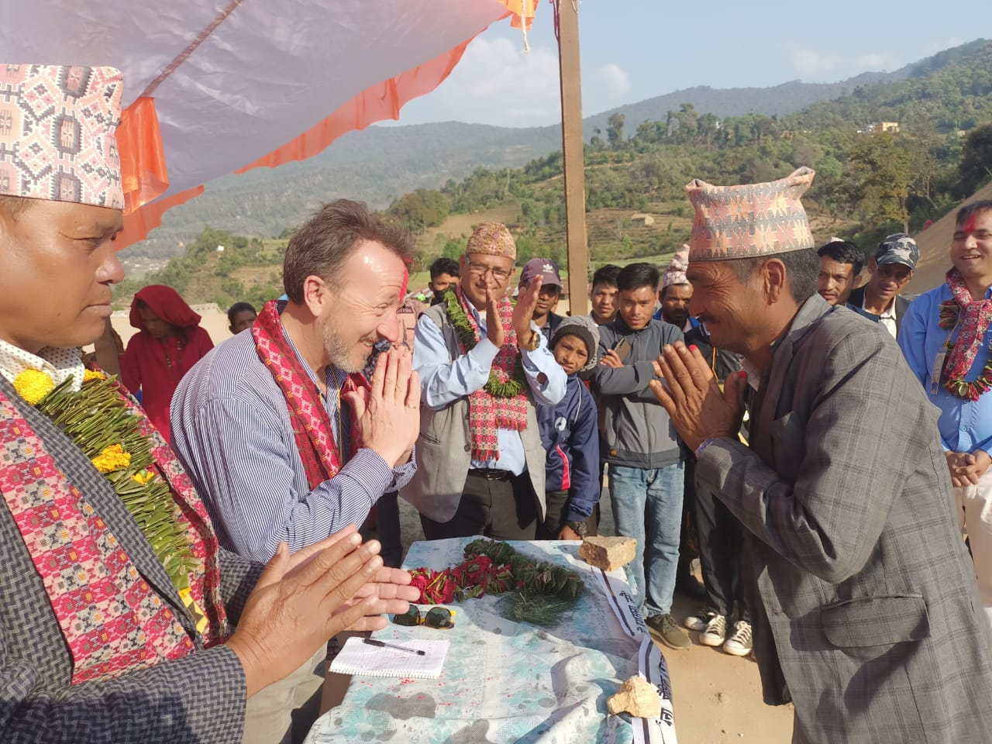
Aims of the project
Aims
To explore how Dēudā culture can be leveraged for peacebuilding, evaluating the disparities between local traditions and peacebuilding strategies.
To investigate innovative communication structures to inform local, national, and international peacebuilding approaches, focusing on enhancing the well-being of youth, especially those from marginalized and remote communities.
Credit: Gobinda Khadka

Slide 20
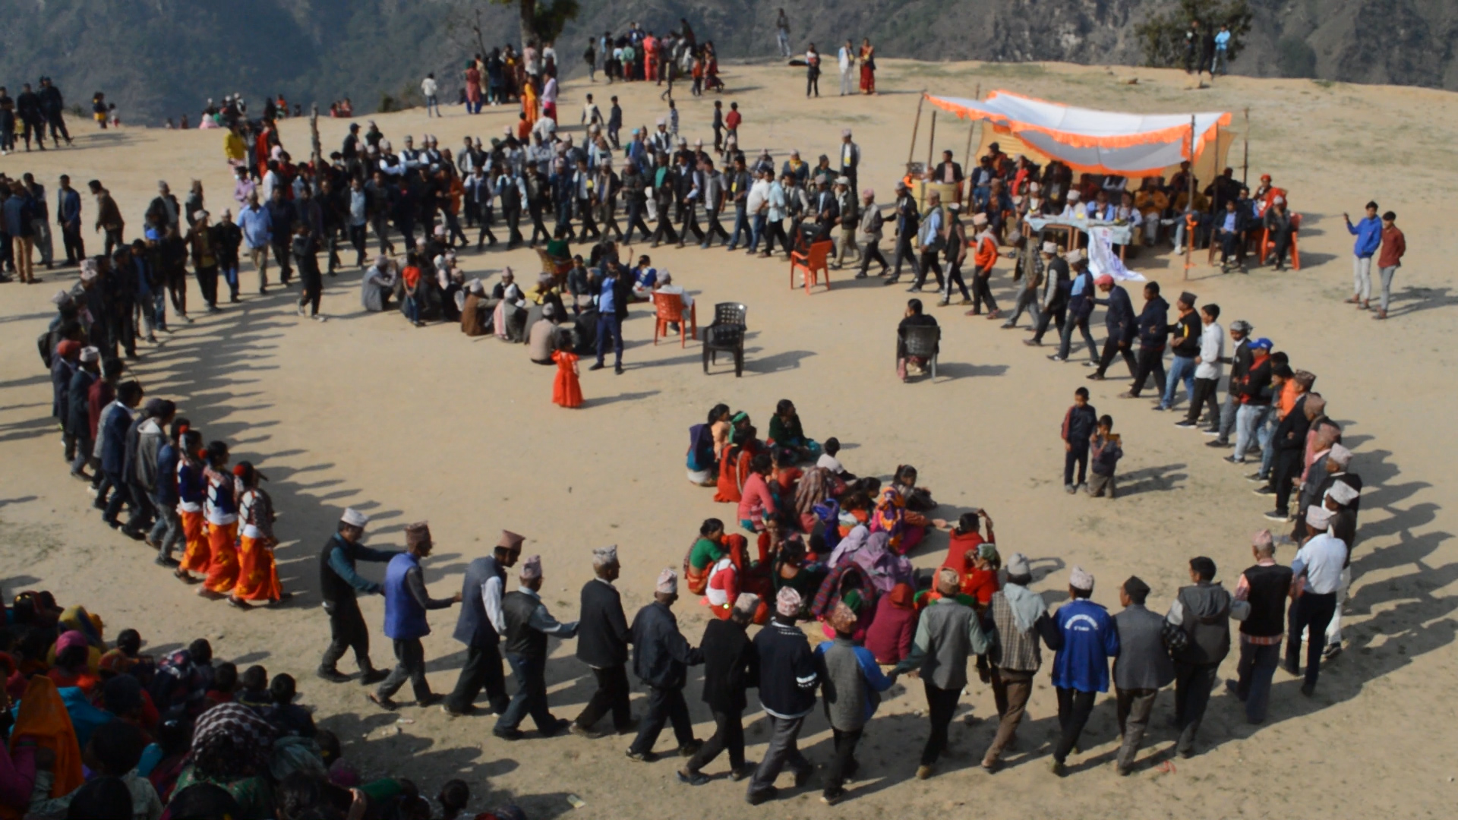
What is Dēudā?
Dēudā folklore (Khel), a traditional Nepali song and dance genre, holds a celebrated spot in the cultural heritage of certain regions of Nepal and India. This folklore, prominently features during various festivals like Gaura, Bishu, Jaat.
It encourages participants to join in a circle, hold hands, and engage in dialogic songs. Its vibrant presence enriches the broader cultural fabric, offering a shared expressive platform for individuals during these community gatherings, and fostering unity and understanding among participants.
Credit: Dila Pant

Slide 21
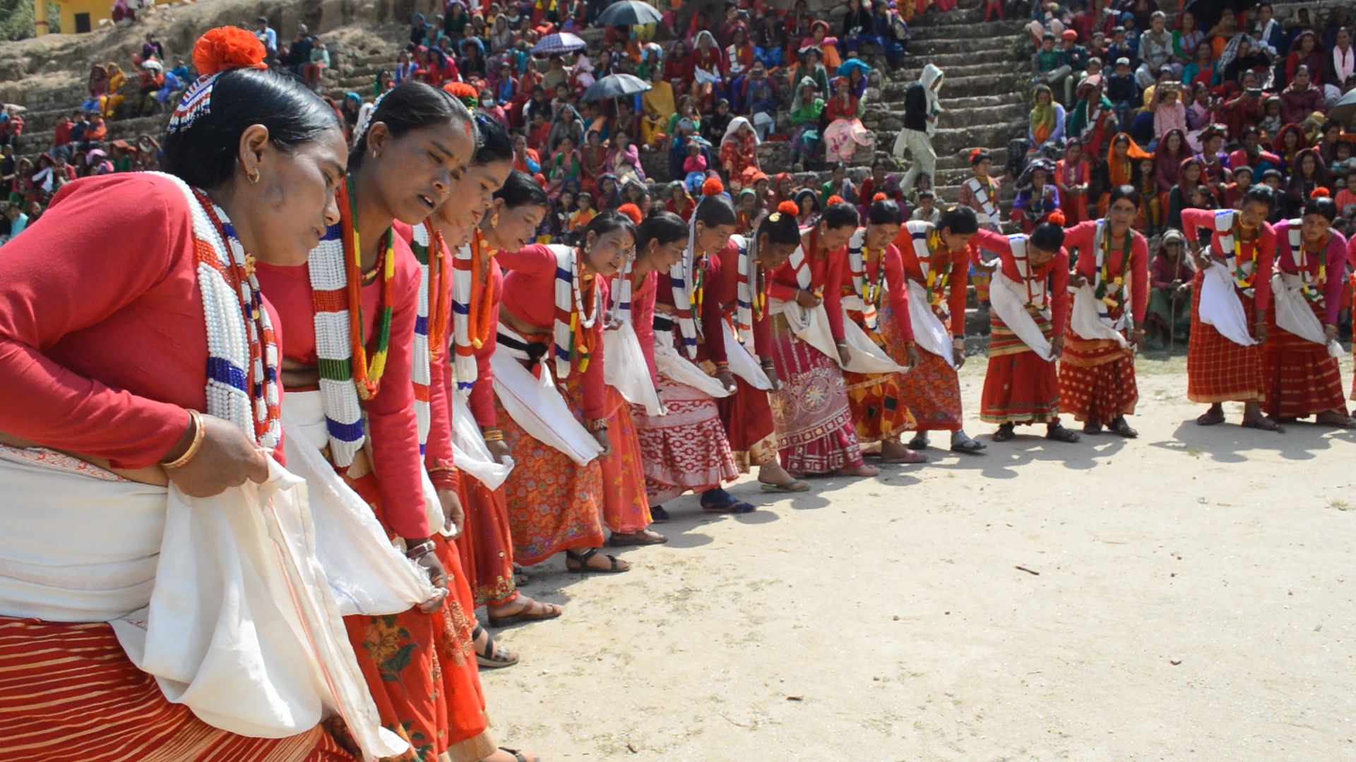
How and does Dēudā folklore evoke dialogue?
At the heart of Dēudā is its openness, its welcoming nature offers an inclusive platform, free from restrictions for participation.
This openness not only encourages shared cultural experiences but also contributes to a unique local peacebuilding initiative.
The psychosocial impacts of Dēudā folklore remain under-researched. A comprehensive understanding of its influence on the community is crucial, and this knowledge gap needs to be addressed.
Credit: Dila Pant

Slide 22
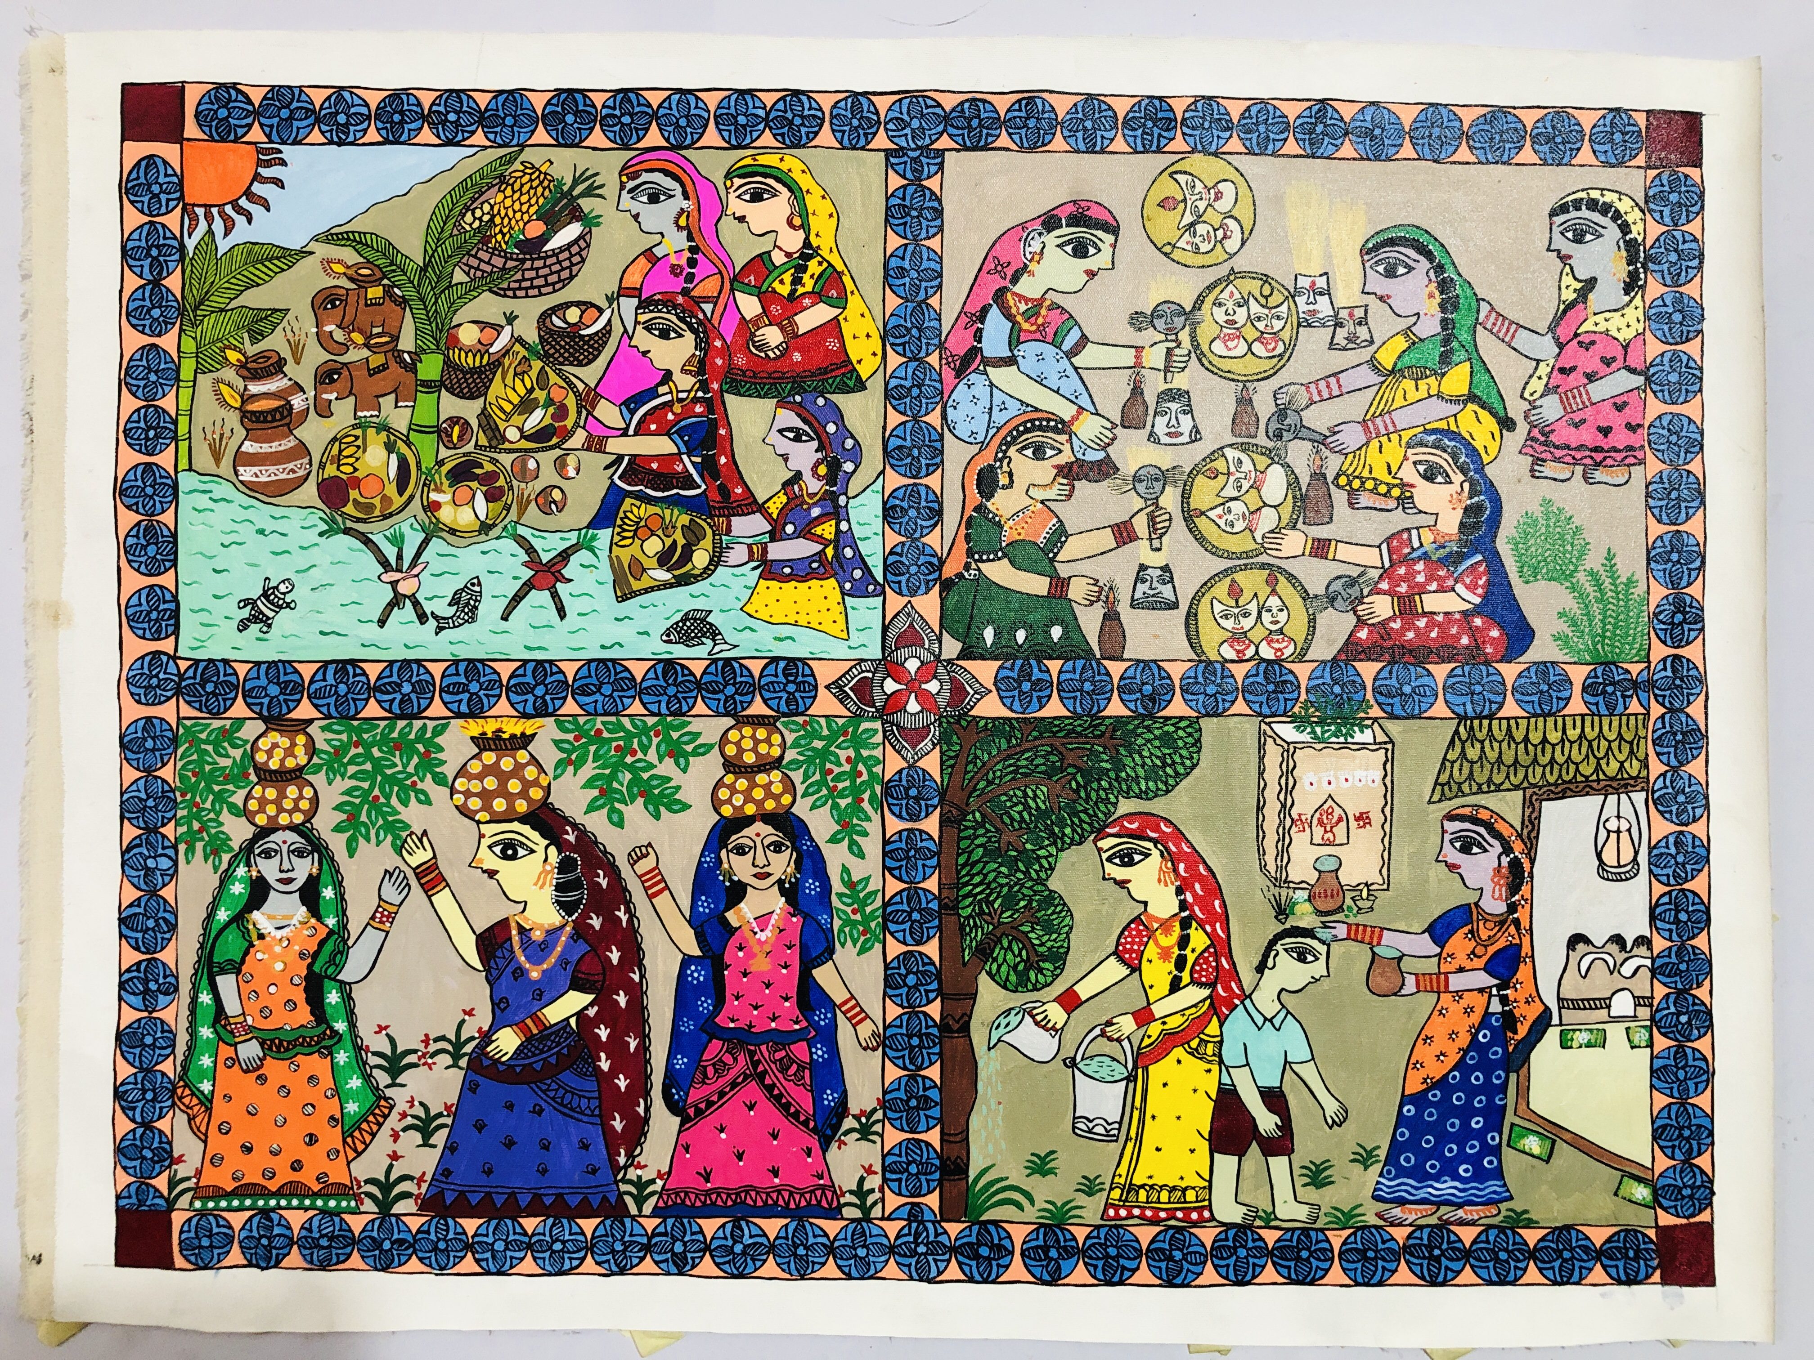
Mithala Arts and Local Curriculum
Creatin of local curriculum with Janaki Women Awareness Society (JWAS) that focused on the use of Mithala Arts from an under-represented part of Nepal (Madhes region). Development of arts education curriculum with Education Department of Kathmandu University.

Slide 23
Beyond Tradition: Revitalising Lenong (Indonesia)
Partner organisations:
Atma Jaya Catholic University
Padepokan Ciliwung Condet
​
Principal Investigator/Co-Investigators:
Indra Nurpatria
Bang Lantur

Slide 24

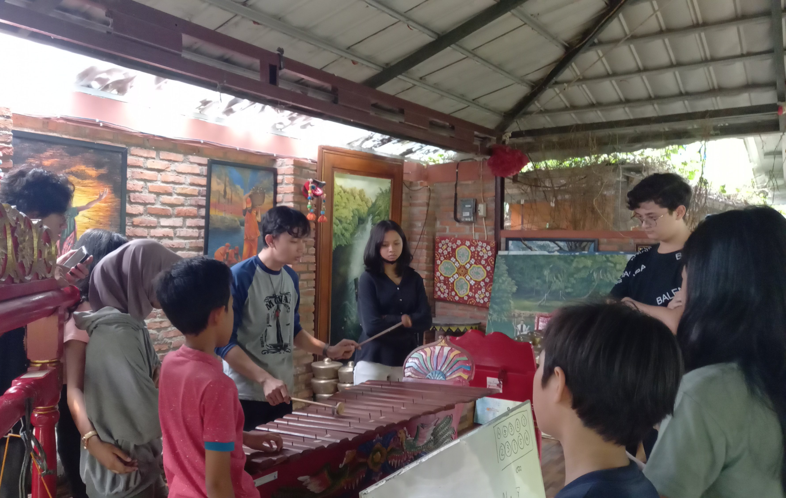
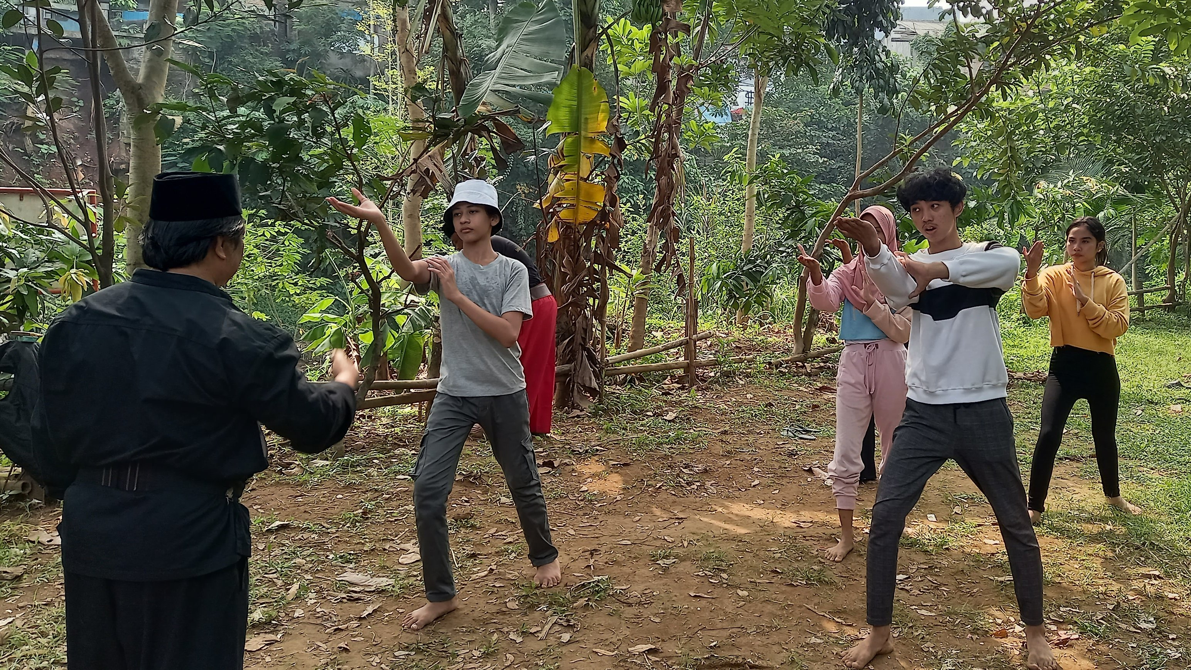
Aims of the project
This project aims to create a module to inform the Independent Education Curriculum for vocational schools in the Jakarta Province in collaboration with the Education & Cultural offices of Jakarta Province.
The module involves young people in the artistic & cultural processes. It focuses on Betawi arts, which includes Lenong, dance, music, martial arts (Pencak Silat) and rhymes (Pantun).
Picture – 2: Young people practicing martial art, or called Pencak Silat. Photo: UNIKA Atma Jaya
Picture – 1: young people practicing Gambang Kromong (a Betawi musical instrument that usually accompanies Lenong performances).
Photo: UNIKA Atma Jaya

Slide 25
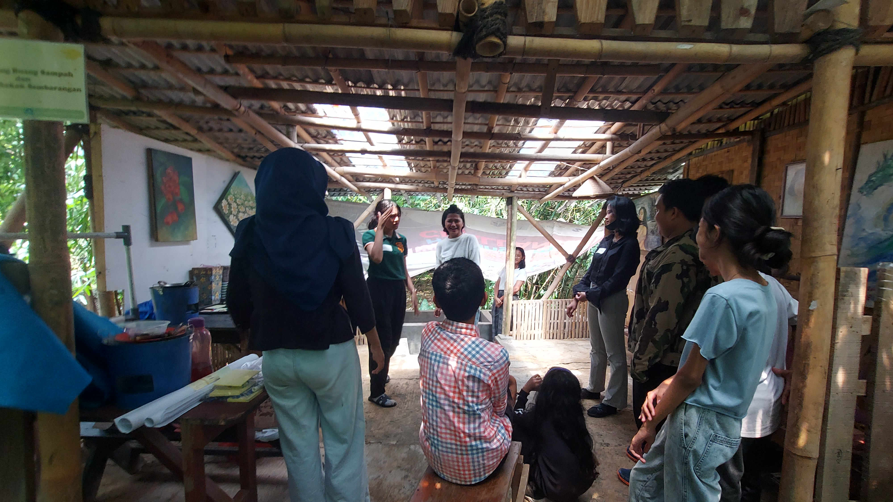
Exploring Lenong
Picture – 4: Beyond Tradition participants preparing a short Lenong performance. Photo: UNIKA Atma Jaya
Saddan Rahmanu and Bea Adinda
(BT young participants)

Slide 26
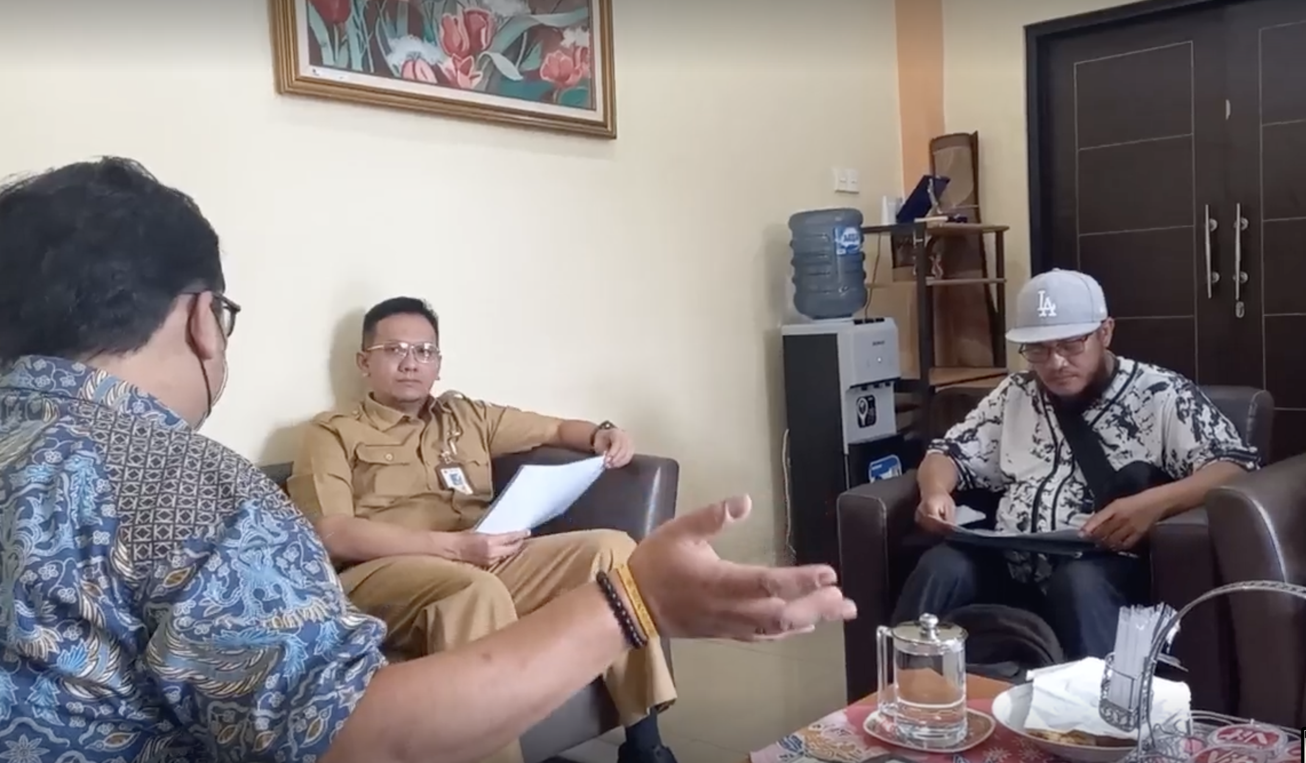
Informing curriculum
Lenong performances used to strengthen mutual understandings/challenge assumptions between young people and audiences.
Co-creating a training module that provides a detailed description of all stages and activities of Lenong revitalisation.
Implementing the learning module with the Education Office and the Cultural Office of Jakarta.
Picture – 6: Audience with Cultural Office of East Jakarta. Photo: UNIKA Atma Jaya

Slide 27
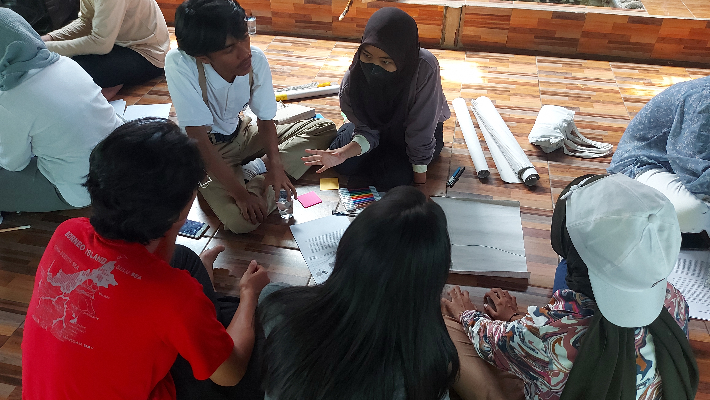
The role of YAB
Picture – 5: River journey workshop led by YAB. Photo: UNIKA Atma Jaya
Kurnia Astuti (Youth Advisory Board)

Slide 28
GENpeace to Influence Policy in Bandung City (Indonesia)
Partner organisations:
Kings College London
Save the Children
​
Principal Investigator/Co-Investigators:
Sukanya Podder
Rendiansyah Putra Dinata

Slide 29







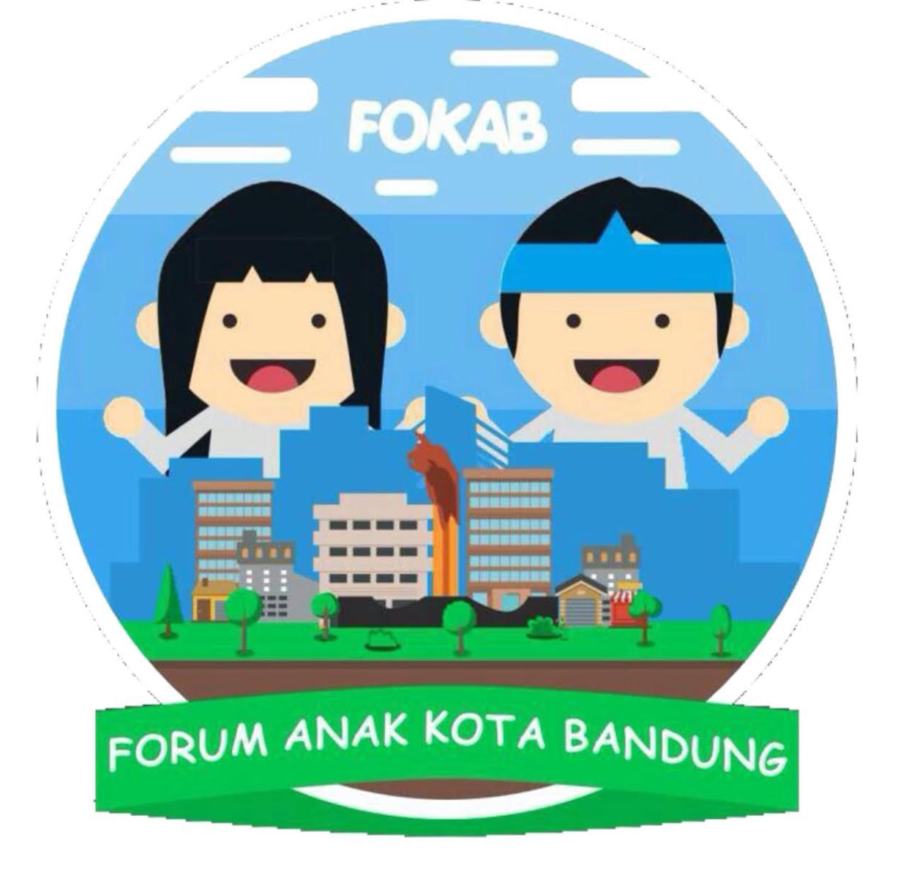
The Process of Developing Art-Forms
for Intergenerational Dialogue to Influence Policy
Kick Off Meeting to engage and provide input from the government and Children’s Forum for the project
Conduct selection process for GENPEACE Ambassadors
Capacity building on child rights, angklung philosophy, advocacy, and content pillar for social media/ PodCast
Workshop to identify child rights issues in Bandung City and develop advocacy asks/recommendation
Transform the issues and recommendations into an art form that will be present in the Musrenbang Process
Regular training to deliver the issues and recommendations through art-based Musrenbang named Pagelaran Anak Panca Sora (Five Voice Children Performance)
Activation of Pagelaran Anak Panca Sora as a model of child-friendly Musrenbang (the first Musrenbang in Indonesia through an art-based approach)
PodCast to follow up on the commitment from the Government
Reflection/ Debrief session to generate feedback and learning from children and youth
Policy dialogue with the National Government for sharing best practices on art-based Musenbang
Integration of the issues and recommendations with Children’s Voice of Bandung City

Slide 30
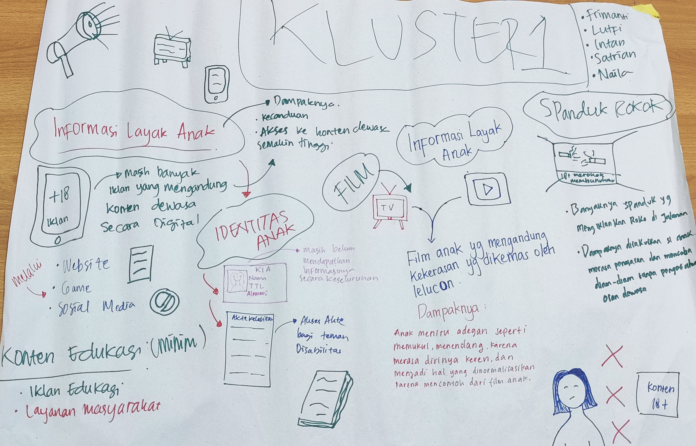
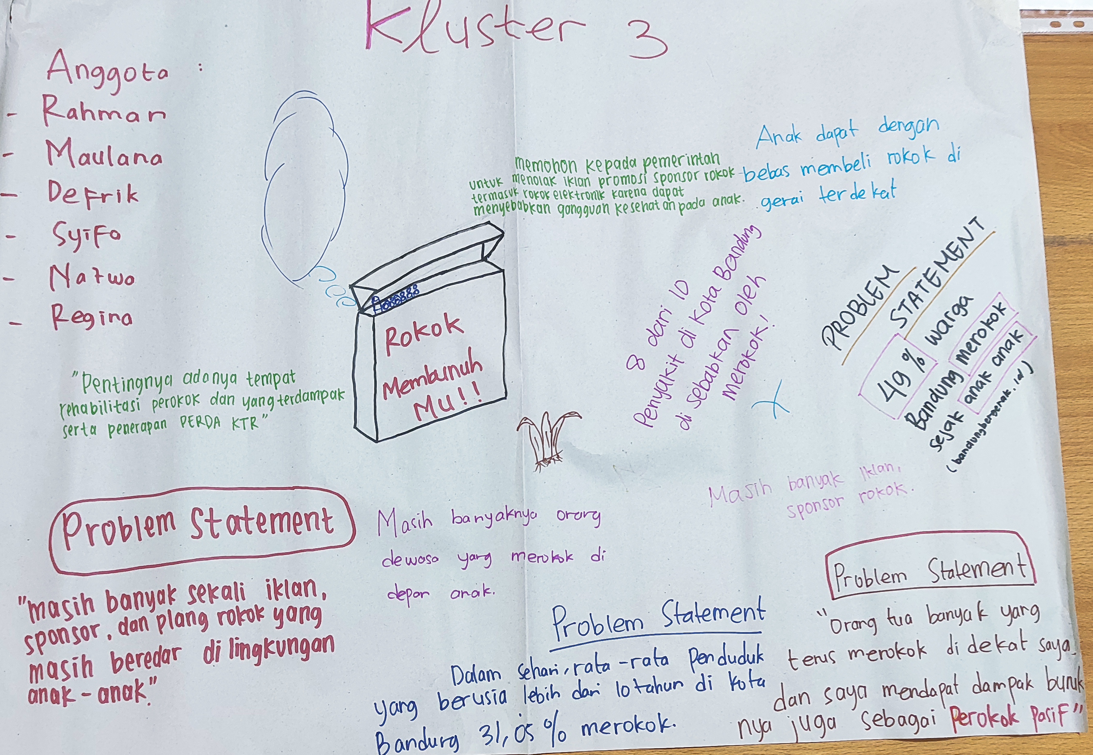
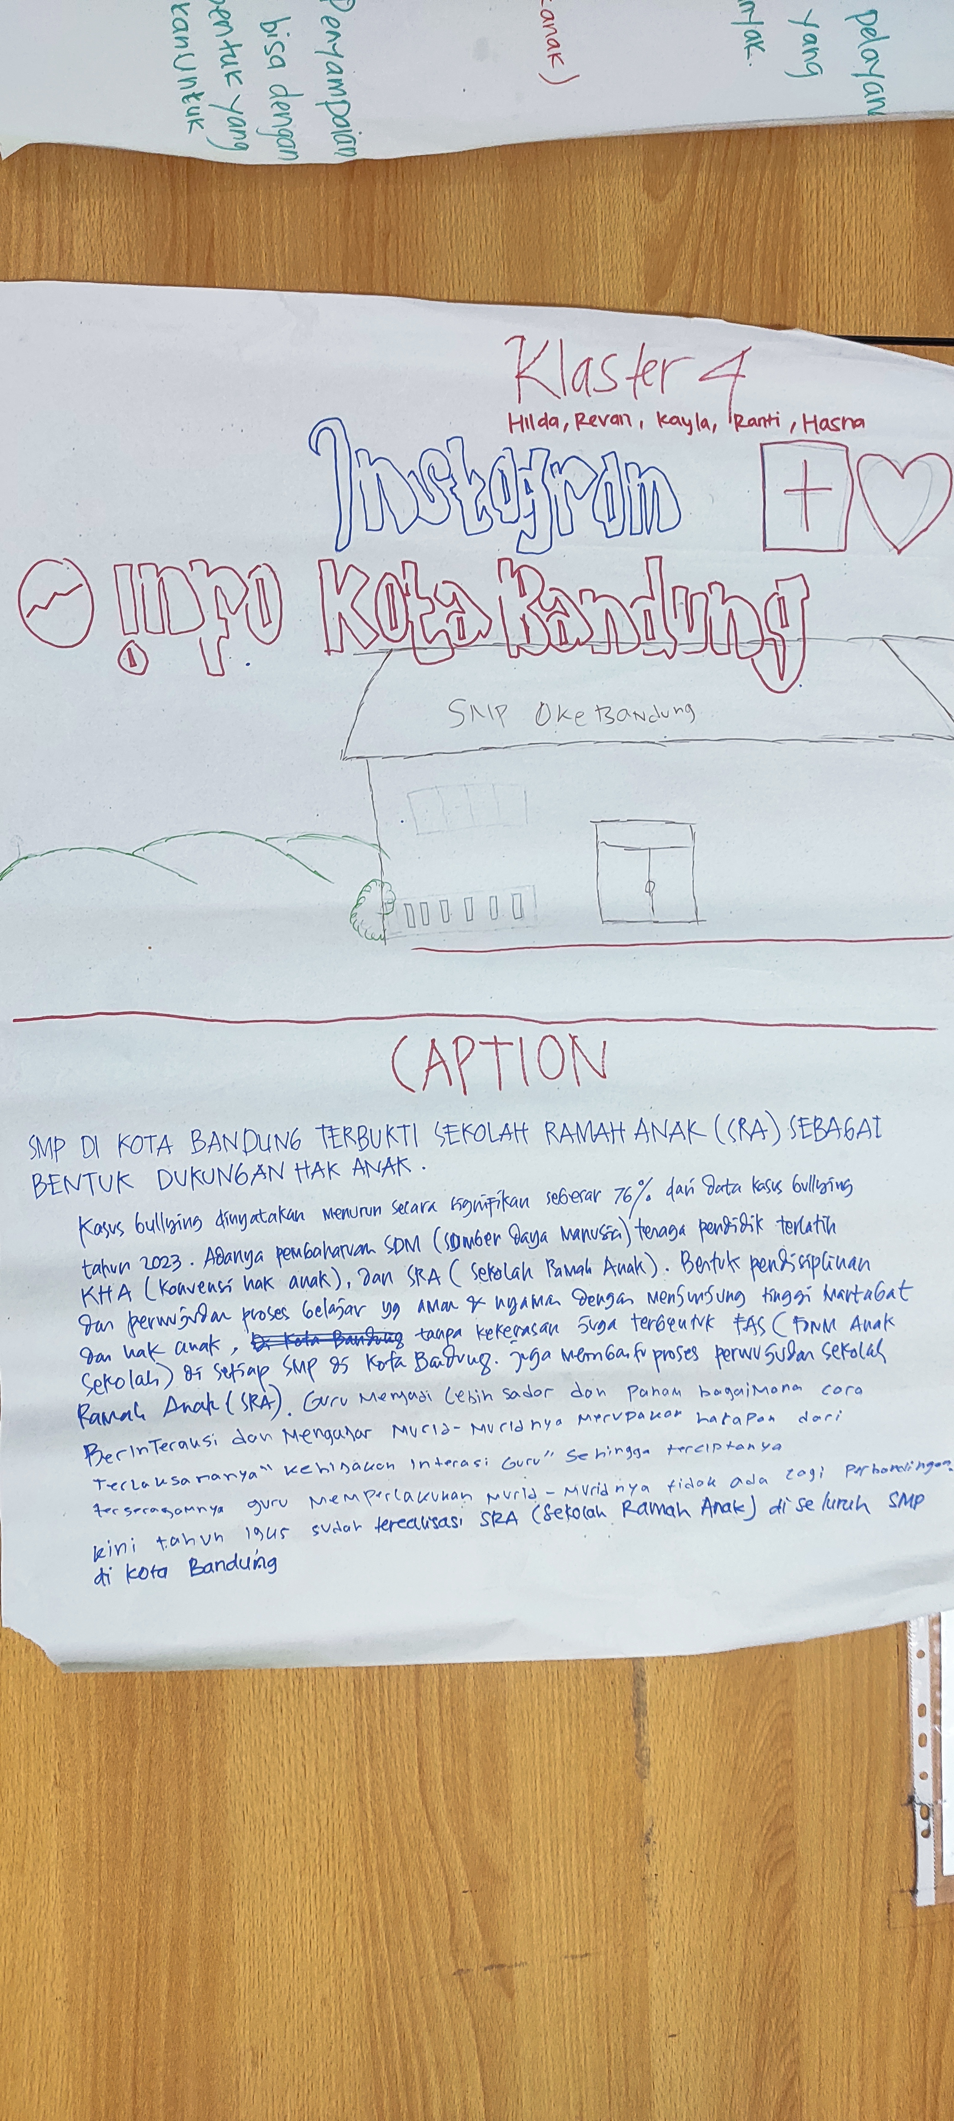
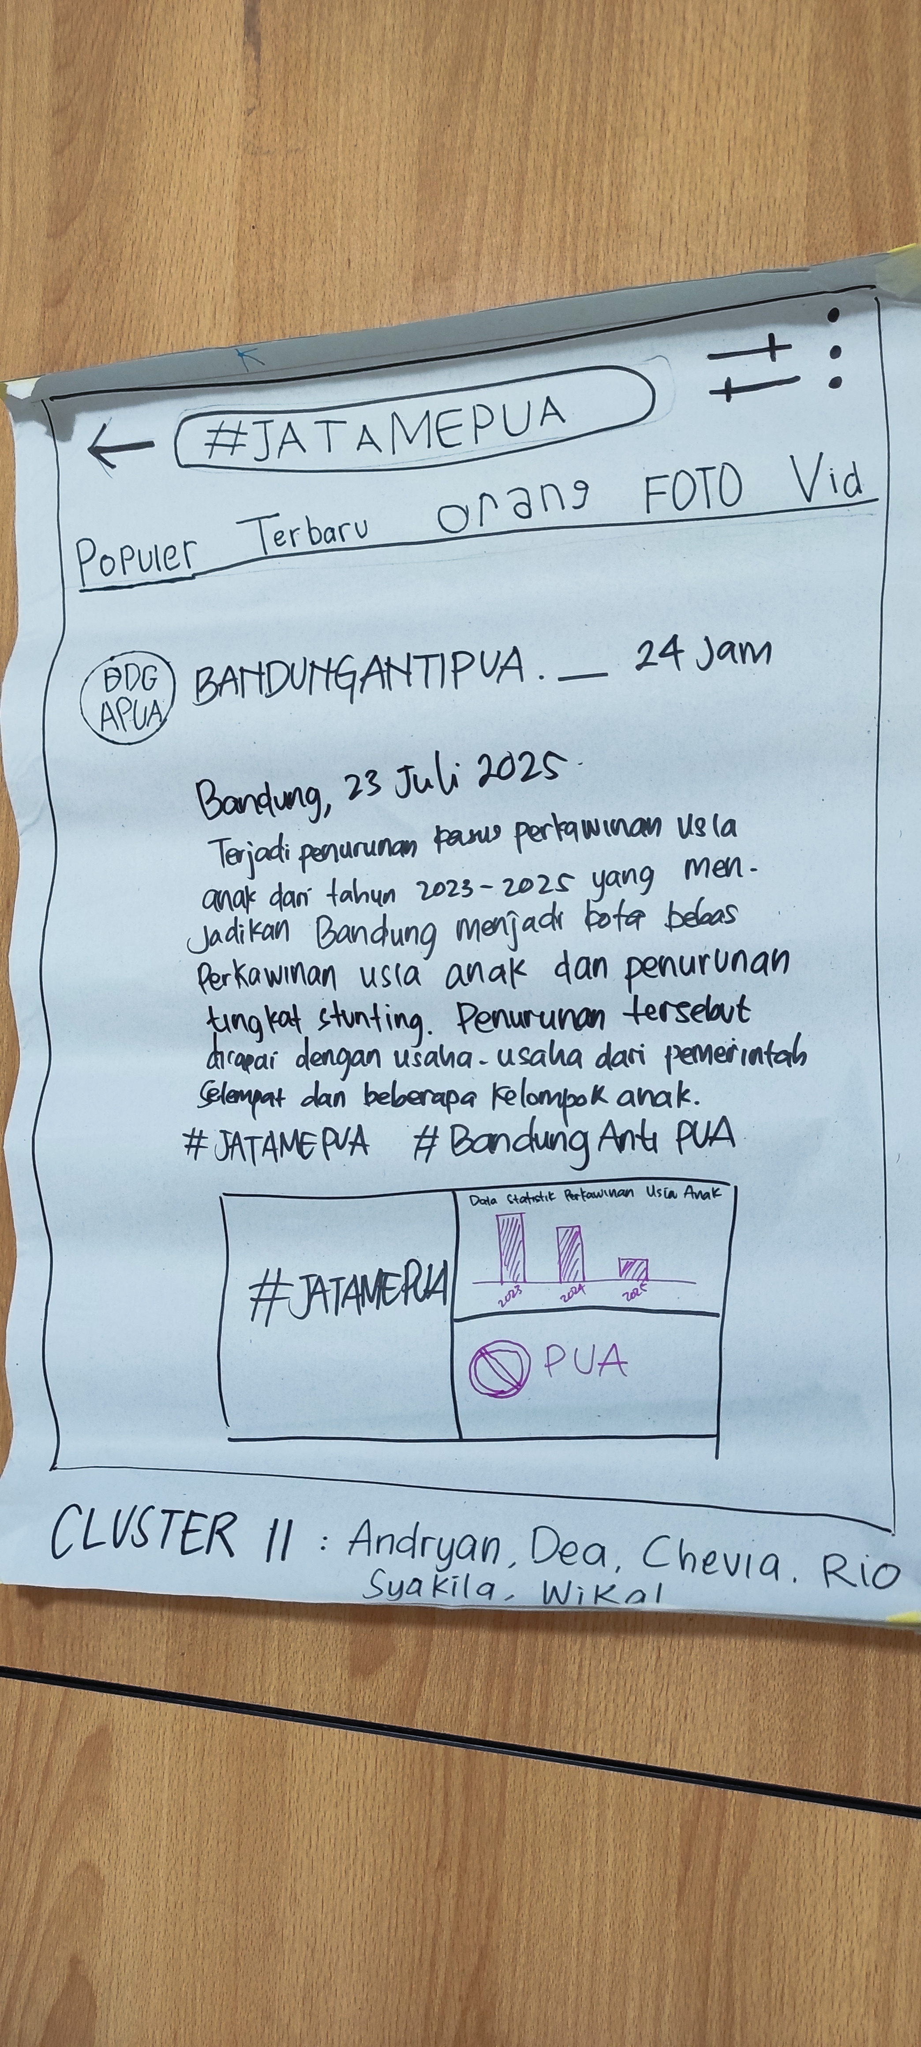
Clus-ter | Issue | Children’s Ask/Recommendation
I | Children in Bandung City have been exposed to information that is not suitable for children, such as bullying, sexual violence, pornography, smoking, etc | Ensure educational and child-friendly content through videos, posters, and articles including the content on internet and social media.
II | Child marriage in Bandung City is still high, putting children at risk of violence. | Against the dispensation of child marriage to reduce the number of child marriages and make Bandung a Child Marriage Free City which has an impact on reducing stunting.
III | Children in Bandung City are at risk of using substances, putting them at risk of violence. | Rejecting sponsored advertisements for cigarettes, including e-cigarettes, which can make children victims of drug abuse.
IV | Schools do not have a child- friendly education system, putting children at risk of violence, such as bullying, physical violence, sexual violence, etc. | Realising Child-Friendly Schools and Child- Friendly Religion Institutions in Bandung City with clean and comfortable environment.
V | There are still children who experience violence in the city of Bandung and are not aware of the existence of the Women and Child Protection Unit (UPTD PPA). | Children understand how to access Child Protection Services when experiencing various forms of violence

Slide 31
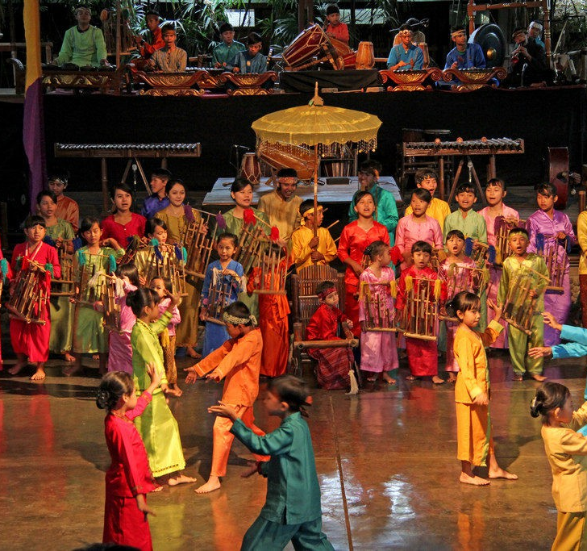
Pagelaran Anak Panca Sora
Model of Musrenbang (Govt. Development Planning Meeting) through angklung cultural art performances and intergenerational dialogue to deliver children’s voice based on five clusters in the child’s right to the Government/Policy Makers
Conducted on Sunday, 3 March 2024
at 1 pm – 3 pm (GMT+7)
Advocacy message amplified through :
Poster/Infographic
Documentation video
Content for Podcast/radio and Social media
Advocacy message delivered through :
Folk Dance
Wooden puppet
Cabaret
Mass Angklung
Original song + Poetry
Participants: 400 participants (including 180 participants funded by the Bandung City Govt), consisting of:
Bandung City Govt.
National Govt.
NGO/CSO/DPO
Children Group and Students in Bandung City
The Government facilitated to provide feedback/response based on the children/youth asks

Slide 32
Informing Curriculum
Mapping local approaches to informing
curriculum
Embedding into HEI structures through Continuing
Professional Development (CPD) programmes
Developing youth leadership through MAP child clubs and researcher clubs
Resourcing existing campaigns and providing training
(MAP at Home)
Networking with cultural organisations and artists to develop resources
Guiding national structures including National Child Forums and
Ministries of Education

Slide 33
Informing Policy
Exploring role of cultural forms for dialogue
Gathering evidence-based data using arts-based approaches
Understanding local and cultural approaches to healing alongside health care providers and institutions
Establishing youth as experts with lived experience to co-produce policy briefs
Networking with
local and regional decision-makers and CSOs to create pathways for impact
Conducting policy roundtables and embedding decision-makers and policy-makers into the MAP journey

Slide 34
Challenges and
Opportunities
Need to engage high level officials with arts-based methodologies and to explore the resistance/biases towards artists/art making and youth as experts/issues of importance;
Sweet spot between formal and non-formal modes of communication and policy-informing structures;
Mechanisms to continually adapt and progress the methods at local levels while embedding within national and formal structures.
Role of Youth Advisory Board (YAB) and youth researchers to implement MEL strategy.

Slide 36


Closing remarks…
Ways to connect
  Website: https://map.Lincoln.ac.uk
  Sign up for our Newsletter
  Check out our Blogs
  Attend MAP Conference (22 – 26 May)
ABreed@lincoln.ac.uk
MAP@lincoln.ac.uk
@Mobile__Arts

Slide 37
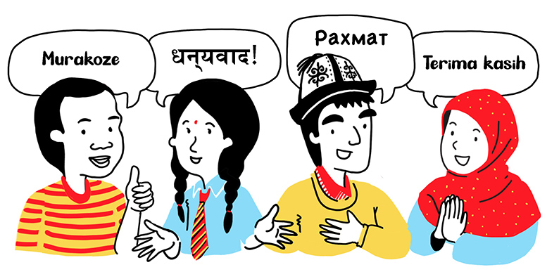
Thank you

Slide 38
Any questions?

