Slide 1



STICKY, SICK, STUCK: RESEARCHING EQUITY IN THE CANADIAN PUBLIC ARTS USING CREATIVE METHODS
Shanice Bernicky, Carleton University (Ottawa, Canada)
PhD Student & Mass Culture Resident Researcher
Practice as Research Speaker Series
December 4, 2023
1
Notes:
[Add to chat] For the script of my presentation, please click here: https://docs.google.com/document/d/1gRmZtskzEfmGTjktJRp0SyEgSwm9TT6nWrErYK4Pt9U/edit?usp=sharing
For accessibility purposes, I am a female-coded person of multi-racial, Black - West Indian and European ancestry.
I am wearing a cream coloured jersey loose long sleeve button up with large light grey headphones. I have thick rimmed tortoise shell glasses.
My name is Shanice Bernicky. My pronouns are she/her/elle. And I am extremely privileged to be joining you from Ottawa Canada, where I am in the fourth year of my doctoral studies in Carleton University's Communication and Media studies program.
[Accessibility ASK room]
I want to first acknowledge that the land on which I love, work, and play and that Carleton University mobilizes is the traditional unceded and unsurrendered territory of the Algonquin Anishnaabeg People.
The Algonquin peoples have been the custodians of these lands and waters since time immemorial and I do not ever forget this.
I also want to acknowledge that the folks that have contributed to this research live and work across Turtle Island, inhabiting traditional territories of Inuit, Métis, and First Nations Peoples.
I do not give a land acknowledgement solely because it is common practice.
In fact, I recognize the hypocrisy that comes from institutions providing one when they are unwilling to provide reparation and enact change.
I give a land acknowledgement because it is from this colonial context as well as shared global historical lineage that my research, regardless of the topic, stems.
More than this, I give a land acknowledgement because it is on these lands and for these lands that I was tasked with building a qualitative framework for a more equitable public arts ecosystem.

Slide 2


AGENDA
1
Research-Creation
2
4
Overview of the Research in Residence project
3
Forward
Sticky
Sick
Stuck
2
Notes:
For today's short presentation, I will first discuss my main methodology of research-creation to introduce the stickiness of my research.
Second, provide a quick overview of the research-in-residence project that I have been part of since May 2021 and the many ways I have felt sick.
Third, I will dive into the methods that I tinkered with to develop a qualitative impact measurement framework --Yes, I know that it is strange to have qualitative and impact framework in the same sentence, but that's what our residency project received funding to do.
Finally, I want to share aloud with you the stuckness that I feel as I try to find my path forward in my doctoral studies and as a human being committed to exploring and upholding acts to decolonize the university and any institution I find myself within.

Slide 3
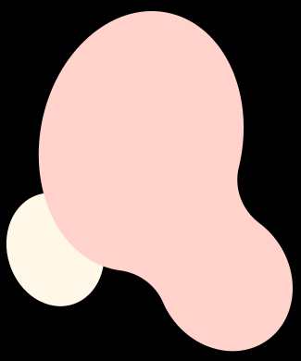

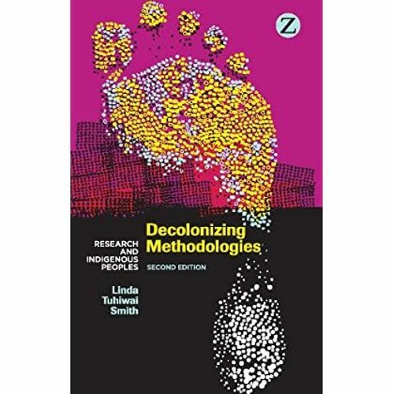

STICKY
RESEARCH CREATION FOR DECOLONIAL PRAXIS???
3
Notes:
Here I start with my first act - Sticky - stickiness or the residue that remains no matter how hard governing institutions try to scrub.
We engage in research in a post-colonial volatile space which requires the consideration of multiple processes of injustice and ever forming criteria of marginalization.
Because of this, I turn to Indigenous studies scholar Linda Tuhiwai Te Rina Smith.
In the chapter “Research through imperial eyes,” Smith traces the colonial roots of western research methods.
In the text, Smith identifies breaks in knowledge that need to be addressed.
For instance, Smith discusses Individuality and society.
Here, the categorization of the self is deconstructed, becoming a foreign and bizarre piece.
The categorization of the individual as a central component of society was not and is not present in Indigenous communities that experience colonization.
Community and holistic approaches to governance are a central way of life for many marginalized collectives.
For the project and honestly, for every other type of research I have done and will continue to do,
Making use of research-creation as a methodology and a method has been essential.
This method stemmed formally in the UK as “Practice-Based research,” where research is directly informed by undertaking a creative and often times, collaborative project.
Drawing from Communication scholars at Concordia University in Montreal, Kim Sawchuk and Owen Chapman’s text entitled “Research-Creation: Intervention, Analysis and “Family Resemblances,” in my own work, I embrace the creation-as-research approach because, quote:
“...it is a form of directed exploration through creative processes that includes experimentation, but also analysis, critique, and a profound engagement with theory and questions of method” (Chapman and Sawchuk, p. 19). End quote.
For me, research-creation works often times do not tell the story of one individual, but can work to demonstrate the importance of communal care.

Slide 4
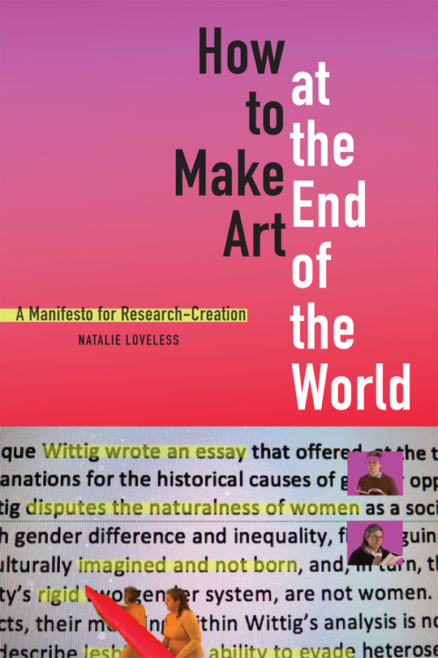
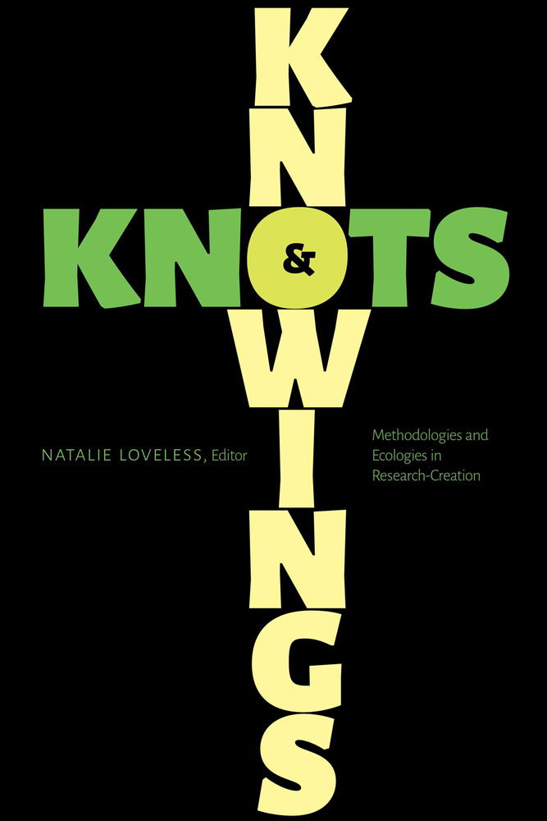
RESEARCH CREATION FOR DECOLONIAL PRAXIS??? - WAIT - MAYBE ANTI-COLONIAL PRAXIS?
4
Notes:
In feminist film and contemporary art scholar Natalie Loveless’s (2020) edited collection “Knowings & Knot,” practitioners, theorists, and community activists come together to review the capabilities of research-creation in capturing and extending affective, queer, anti-racist, and anti-colonial intervention.
Loveless’s research-creation practice asks researchers to evaluate how they do, what they do and for whom? (p. 225).
With research-creation, a project's free-range ability allows for expressions that cannot be otherwise captured.

Slide 5


SICK
SETTLER-COLONIAL STATES AND THE ARTS SECTOR
“The diversity paradigm essentializes difference in the guise of celebrating it. It reduces inequality to generalised particularity, and it ignores historic oppression as the basis for multicultural struggles.” (Audrey Kobayashi, 1991, p. 34)
5
Notes:
So, how have I applied research-creation to my work at the PhD level?
I am lucky enough to be one of 6 resident researchers for Mass Culture, an art support organization who's network spans across turtle island. For this Mitacs-funded project, us researchers had the ability to pitch our own projects.
As someone who has thought about equity, diversity, and inclusion as distinct processes all my life. My research stems from a place of lived experience and academic curiosity.
I provide this quote by policy scholar Dr. Audrey Kobayashi because it really demonstrates the messiness of this work.
Kobayashi writes QUOTE:
The diversity paradigm essentializes difference in the guise of celebrating it. It reduces inequality to generalised particularity, and it ignores historic oppression as the basis for multicultural struggles." END QUOTE
This is where I become sick the first time.
Equity is an afterthought in many of the EDI plans scholars I reference in my research have come across.
It seems that a more diverse staff, leads to more equity which is not the case.
So instead, my project challenges this trend, searching for a way forward by harnessing the artistic license of the arts and culture sector. Maybe this might ease the nausea that I feel in my gut and in my heart.

Slide 6
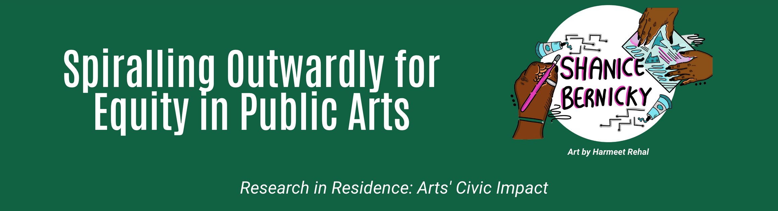
7
Notes:
The process of the research has been two-fold:
Developing equity and inclusivity indicators and an impact framework for the cultural sector
AND
Developing a framework with impact indicators within a virtual maker-space setting.
This project brought together members such as (and this list is not exhaustive) artists and/or cultural workers who publicly identify as Indigenous, a Person of Colour, Black, a Person with Disabilities (hidden or not), or a member of a LGBTQ2+ community.
More than anything, this project has strived to foster an equitable space, bringing together myriad perspectives to share and build new ways forward.
My axis of intervention heavily focuses on the commitment to equity, diversity and inclusion principles amongst arts and culture organizations. As part of my residency with Mass Culture, I was tasked to produce a civic impact framework based on fieldwork.
It has been a bizarre, rewarding, and all-consuming process to say the least. Here I feel sick because - measuring something that you know deep down cannot be measured - to be measured is to go against the principles of collective action and care.
BUT - the ability to measure is a powerful tool for communities experiencing marginalization. Using metrics to hold institutions accountable to what they said they would do, and by when.
So we can't just throw away quantitative data - the issue is that we are saturated with it - bursting at the seams with all this numerical data that gets filed away. We need not an alternative, but a more expansive, hollistic method which can be used by participants as well....

Slide 7
Main Method: Maker-Space Gatherings
Adaptation of the “walking interview” - making together while we explore a common theme.
METHODOLOGY & METHODS...METHODS BECOMING METHODOLOGY?
Reverse-Audiovisual Elicitation
Adaptation of the “walking interview” - making together while we explore a common theme.
Maybe...Probably not (but that’s okay!)
Feminist Manifestos
Feminist manifestos call forth a radical tradition that amplifies the importance of collective thinking
7
Notes:
To do this, my main method to build the framework was through a participatory method I am calling "Maker-space" gatherings.
[Maker-space gatherings brought folks together virtually to use texture, sound, image, shape and colour to describe how they interpret equity, diversity and inclusion]
To respond to the questions like “How do you feel about EDI plans broadly?” or “As a cultural/arts worker, what are some of the challenges of fostering a more equitable and diverse space/program?” collaborators were invited to search through a creative commons image and sound database with sensory prompts on the board like: If you could describe EDI using a texture, what would it be? If you could describe EDI using a sound, what would it be? This is reminiscent of photo-elicitation, soliciting reactions based on visuals (Rose, 2016) but in reverse.
The shapes, sounds, and textures not only tease out some of the deep reflections but also provide much-needed relief from a heavy, and triggering subject.
The final method (for now), feminist manifestos has three characteristics that I hope to adopt as this project is still ongoing.
First, feminist manifestos call forth a radical tradition that amplifies the importance of collective thinking.
The RinR framework that was developed, broken apart, rearranged, and built over and over again has strong links back to the voices of the 8 collaborators who joined both maker-space gatherings.
Responding to myriad inequities across the sector is not something any one person can do alone. Collaborators were also invited to engage in a review of their quotes and the entire framework and received compensation if they were engaging outside their work hours.
Second, manifestos act as political interventions and disrupt typical procedures (Taylor et al., 2023). This characteristic is one that is peppered throughout the framework’s text. Using action sentences, prompting reflection of the reader, and providing a sort of list of demands.
Third and finally, QUOTE:
“Another admirable aspect of collective feminist declarations is their tendency to contain elements of both theory and practice and still to be written in ways that prioritize accessibility” (Weiss, 2018, p. 23).
One of the main goals of the RinR project was to ensure accessible access to each of the frameworks developed.
The public has been able to follow along with the research every step of the way.
We’ve also prioritized using accessible language and creating video explanations of the frameworks.
The eventual publication of this research will be submitted to an open-source journal so that folks do not hit the paywall to engage.

Slide 8

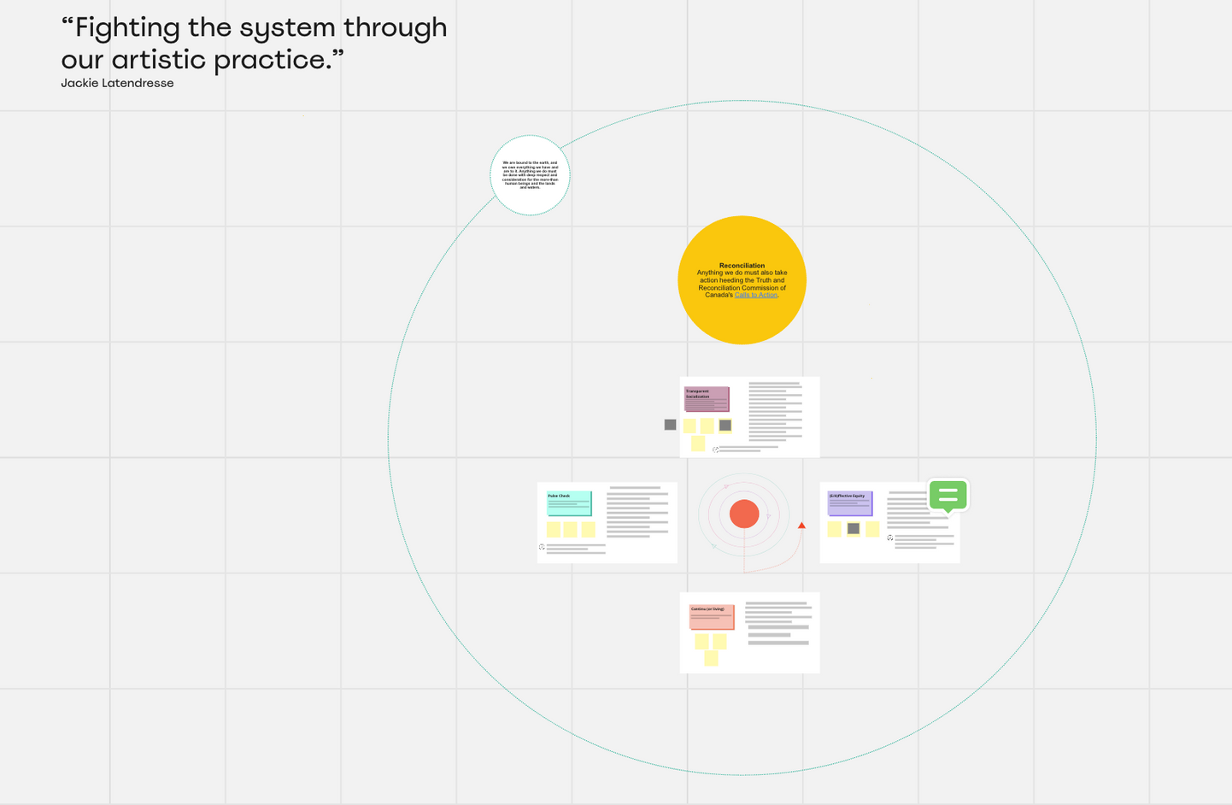

“FIGHTING THE SYSTEM THROUGH
our artistic practice.”
Jackie Latendresse
Elana Bizovie
Annalissa Crisostomo
Em Ironstar
Crystal Massier
Shauna R.
Valeria Duarte Reyes
Johnny Trinh
8
Notes:
The framework is a spiral existing in an open terrain that encourages movement, winding down onto itself into a core point, only to spring out, becoming larger and larger after each component is engaged. It encourages process, rather than progress.
This approach acknowledges that process and progress are two distinct entities.
The former presupposes that each choice builds one articulation of a constructed assemblage, and the latter assumes there is a final destination.
In the case of equity, there is no destination, because if we assumed there was, we will have missed the point. With process, what happens is as the spiral becomes larger, the pillars begin to intertwine, and their interventions, become natural processes to all parties engaging with them.
Moreover, the four pillars act either for process through guidance or as communal qualities depending on the level of engagement by an organization.
The pillars developed from the maker-space gatherings and built upon from roundtable conversations in Whitehorse, the Yukon and Edmonton Alberta, and Toronto, Ontario are as follows:
1. Pulse Check – surveying the terrain
2. Transparency and Socialization – Community engagement and transparency throughout development
3. Effective and Affective Equity – concrete and realistic measures and plans. (Though Affect is qualitative – can’t be measured or at least not in a uniform way)
4. Continu (or living) – always unfinished because there is no end to this work. The cycle, adjacent to the current one we live in continues.
Indicators were tricky - they are meant to have a check box beside them - a way to say "I've done this" a way to say "I've got x points" but I decided I wouldn't do that. I'd frame the offerings of collaborators as principles for human and more-than-human care.
How do we measure equity?
That is something only each individual can generate for themselves.
I would be lying if I didn’t say that I am caught in the intricate web of this project.
How do I maintain the tension between reporting data to identify an increase in diverse staff, organizations, and projects alongside qualitative experience and feelings full acceptance?
How do I develop indicators that uphold the importance of constant reevaluation, but also provide a static impact framework?
Interpersonal challenges:
1. Long history of extractive scientific and environmental research taking place in Northern communities by southern researchers and teams.
2. Relationships between community members and organizations/government charged
3. My own positionality as a researcher/outsider/always arriving marginalized
4. Time
5. Failure and immediacy - immediacy breading feelings of ethical failure as a researcher. I want to ensure that my collaborators are just that, collaborators and not participants but the constraints of academia and industry work make this difficult. It is also difficult to wear so many hats as a PhD student and have the time to conduct participatory research with the devotion it requires.
This is a long list of challenges, but challenges are not at all negative. With challenges comes work. With challenges comes solution generating and this cannot be done alone.
There is so much more that I want to say but most of it has not yet been processed by me both tangibly and emotionally.
But one thing is for certain, the most invaluable and important piece of this research has been to develop community relationships and to nurture them.

Slide 9
STUCK
A Non-Conclusion, not a Non Sequitur.
9
Notes:
The framework has been released but I am stuck because I am still processing bouncing around the distinct identities and expectations of three different cities in two different provinces and one territory.
I am stuck because funding dries up, people change vocations, and life goes on but everything in this work has no end.
I am struggling with writing a journal article on this research, because I cannot seem to conclude with anything other than this is a non-conclusion. I am stuck because I am afraid that once I wrap things up in the traditional sense I have to move on. But how do I move on when I am only now given the space to think more deeply about how this process has been?
Though. what I can say is that the research-in-residence project is now in its use-case study phase where I am paired with an arts organization to adapt the framework for their realistic needs. So maybe I forgo a conclusion for now...

Slide 10


THANK YOU!
Feel free to reach me at : shanicebernicky@cmail.carleton.ca
Visit this webpage for more about the Researcher-in-Residence project: https://massculture.ca/research-in-residence/
10
Notes:
I thank you all very much for attending today's session. I want to thank Dr. Nicole Brown for all her work for the PAR network.
I do hope that we can continue the conversation throughout the session and beyond.
I am always available by email.
Feel free to reach me at: shanicebernicky@cmail.carleton.ca
Visit this webpage for more about the Researcher-in-Residence project: https://massculture.ca/research-in-residence/

Slide 11
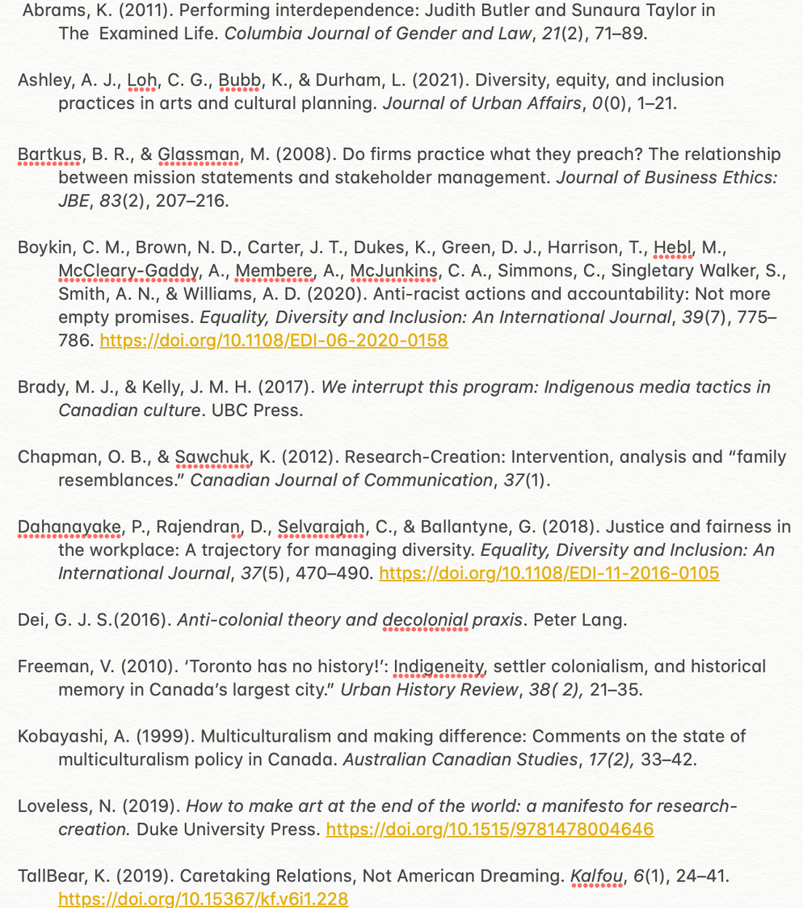
ACADEMIC RESOURCES
11

